Slide 1
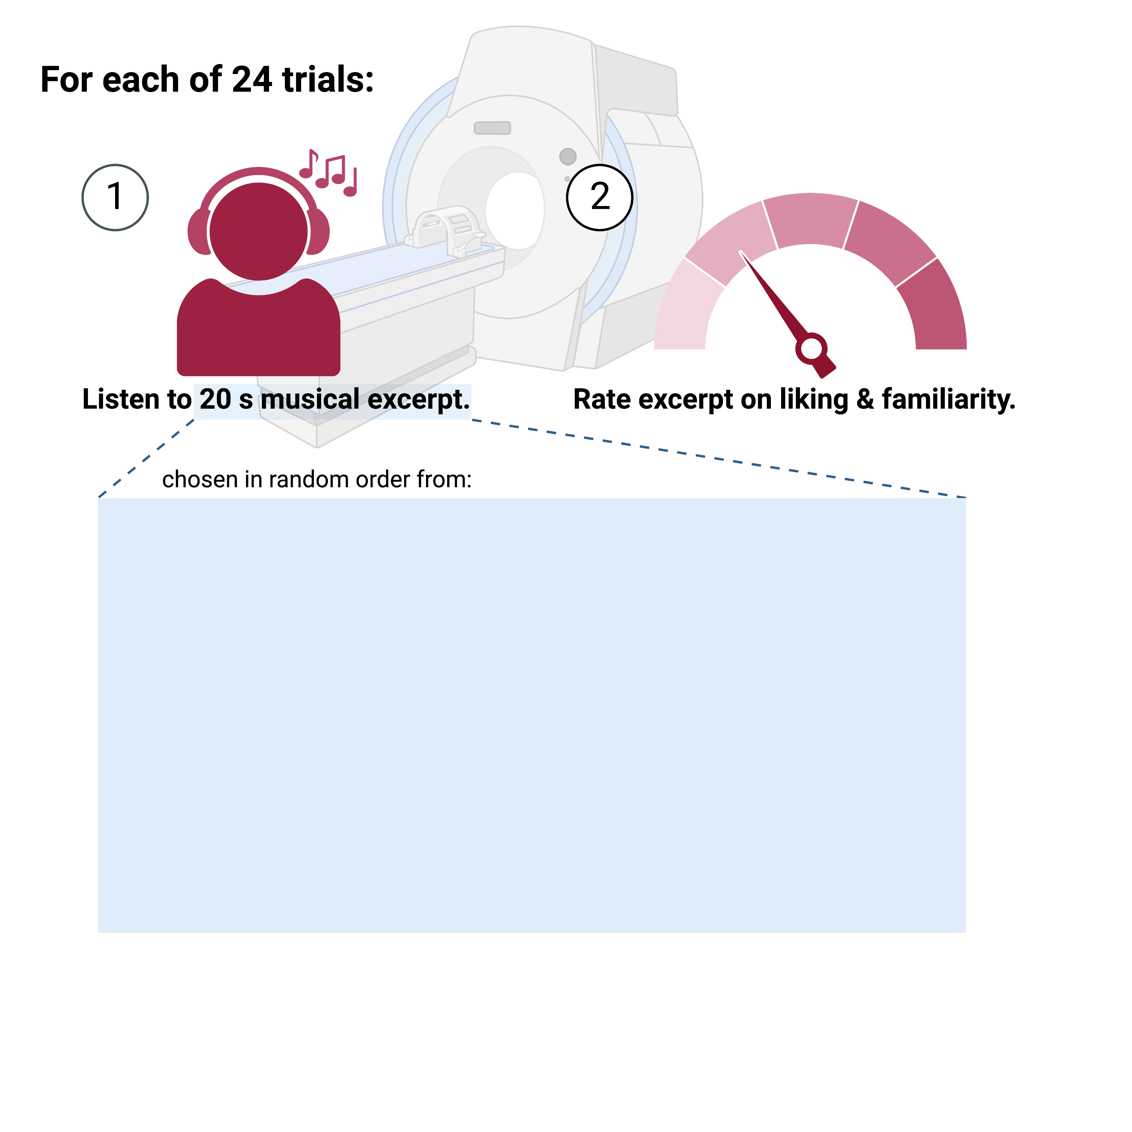
Stimulus # | Stimulus Type | Vocal?
1-6 | Self-Selected Excerpt | Y/N
7 | Other-Selected Excerpt: Adagio for Strings | N
8 | Other-Selected Excerpt: Symphony No. 2, Finale | Y
9 | Other-Selected Excerpt: Cavatina Op. 130 | N
10 | Other-Selected Excerpt: "John Wayne Gacy, Jr." | Y
11 | Other-Selected Excerpt: "Hurt" | Y
12 | Other-Selected Excerpt: "Sound of Silence” | Y
13 | Other-Selected Excerpt: "Reckoner" | Y
14 | Other-Selected Excerpt: Nocturne in C Sharp Minor | N
15 | Other-Selected Excerpt: Nessun Dorma | Y
16 | Other-Selected Excerpt: Symphony No. 6, Mvt 1 | N
17-24 | Novel Music | N/A

Slide 2
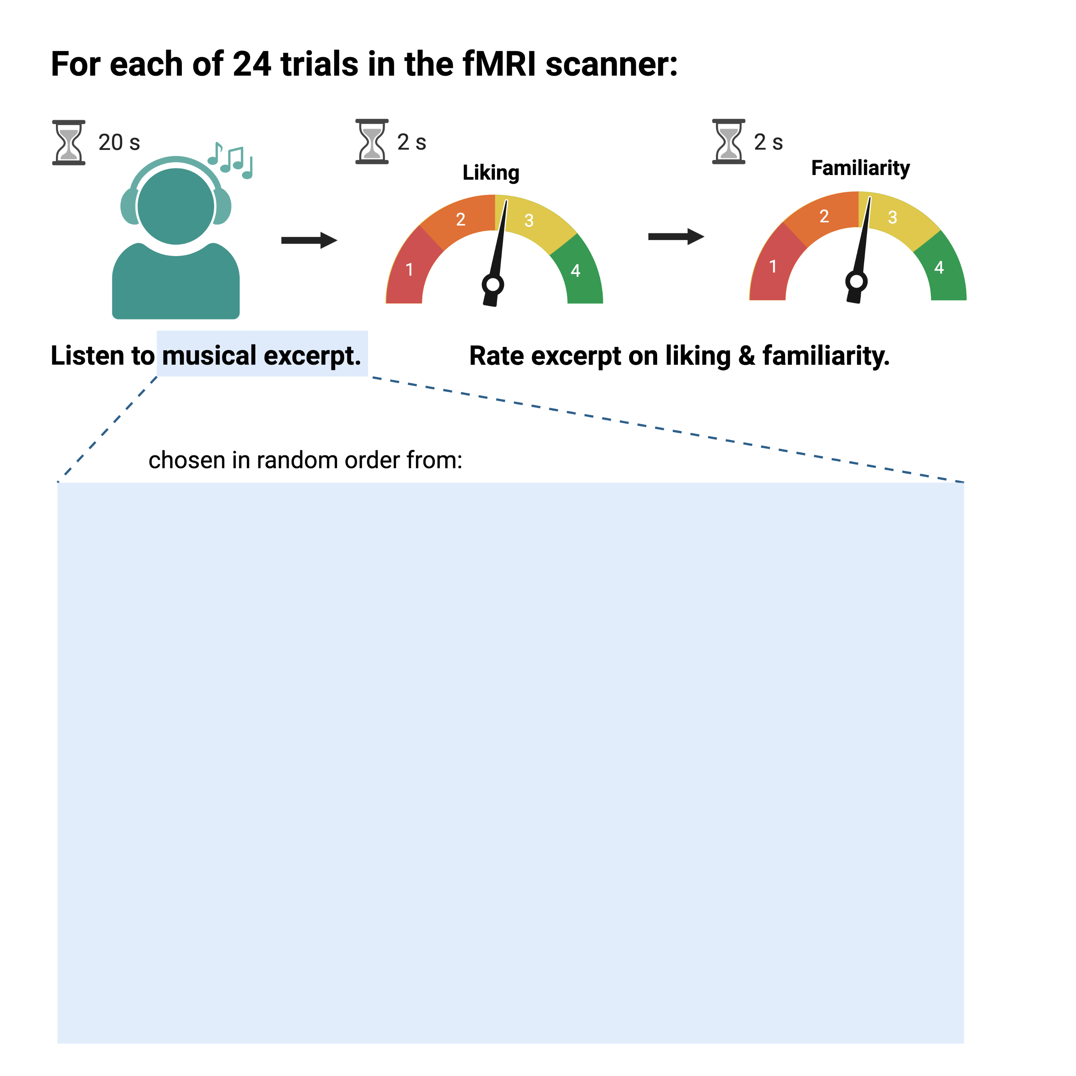
Stimulus # | Stimulus Type | Vocal?
1-6 | Self-Selected Excerpt | Y/N
7 | Other-Selected Excerpt: Adagio for Strings | N
8 | Other-Selected Excerpt: Symphony No. 2, Finale | Y
9 | Other-Selected Excerpt: Cavatina Op. 130 | N
10 | Other-Selected Excerpt: "John Wayne Gacy, Jr." | Y
11 | Other-Selected Excerpt: "Hurt" | Y
12 | Other-Selected Excerpt: "Sound of Silence” | Y
13 | Other-Selected Excerpt: "Reckoner" | Y
14 | Other-Selected Excerpt: Nocturne in C Sharp Minor | N
15 | Other-Selected Excerpt: Nessun Dorma | Y
16 | Other-Selected Excerpt: Symphony No. 6, Mvt 1 | N
17-24 | Novel Music | -

Slide 3
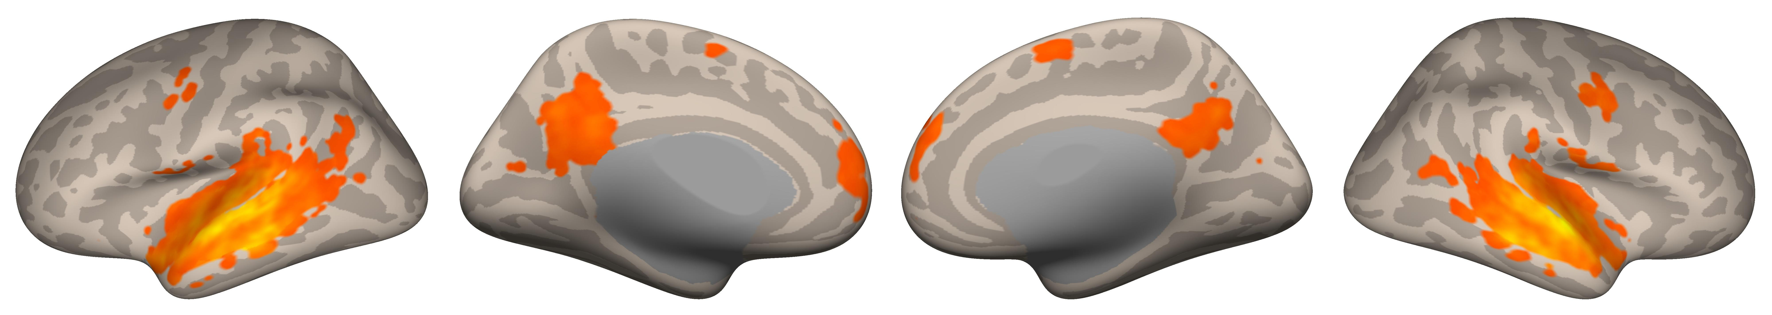
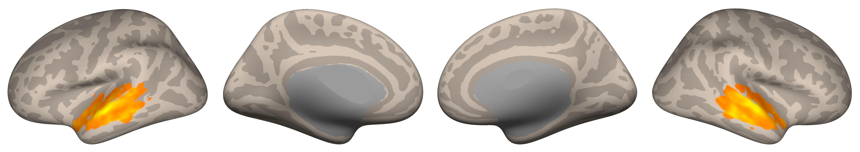
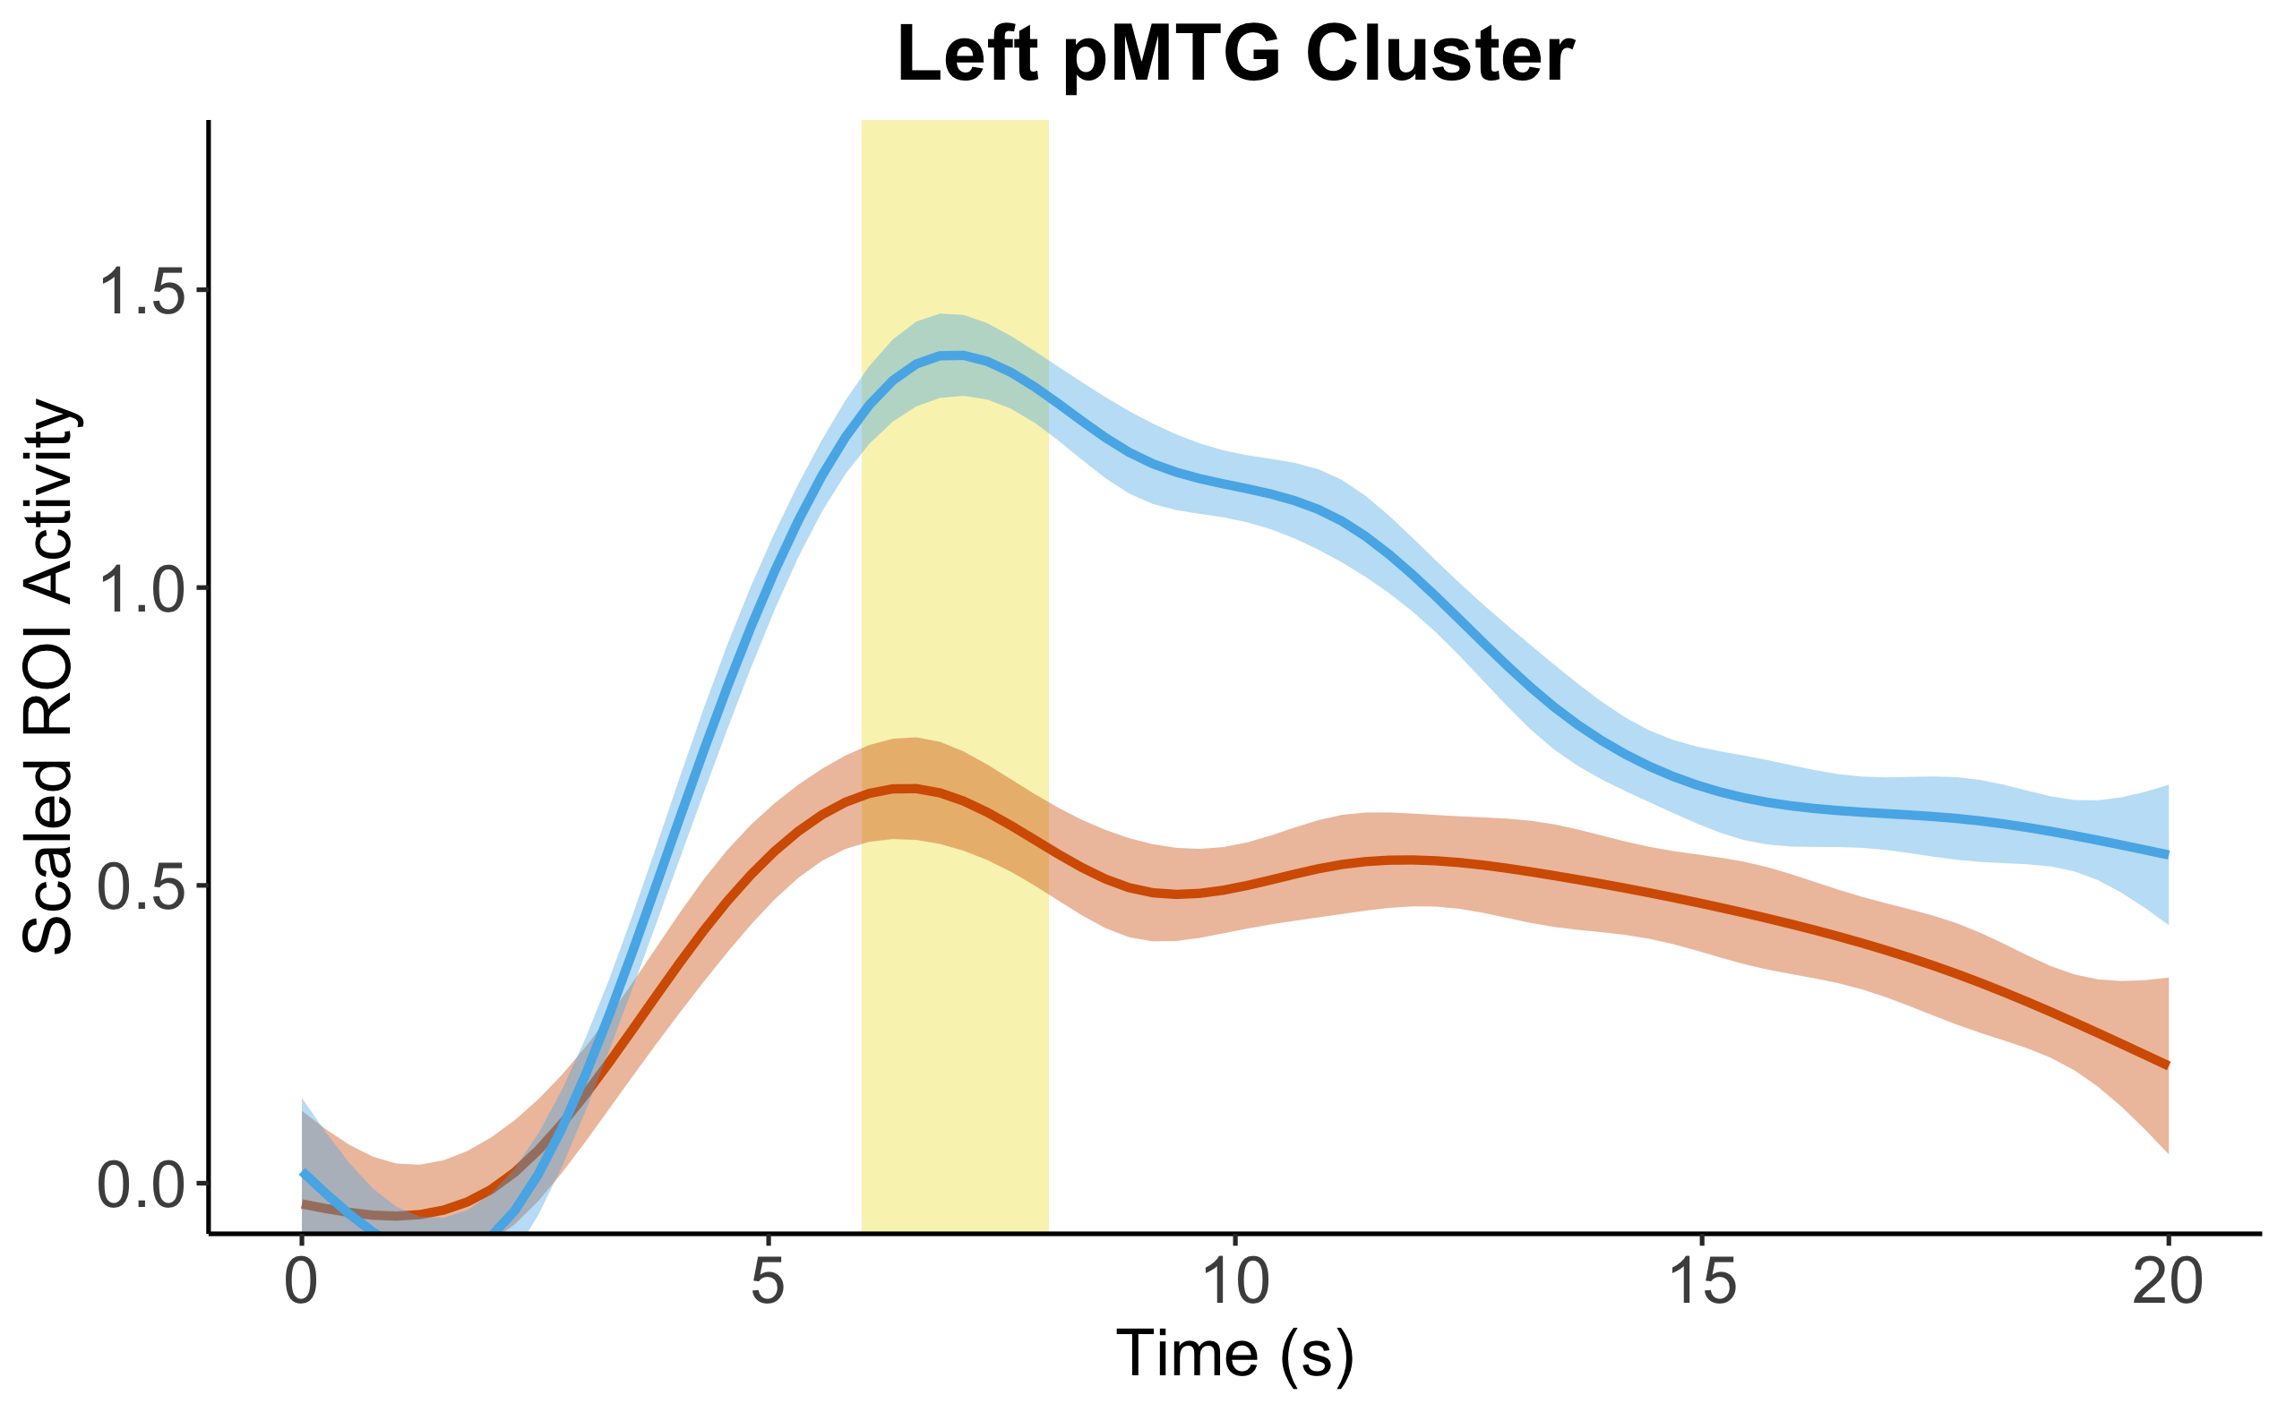
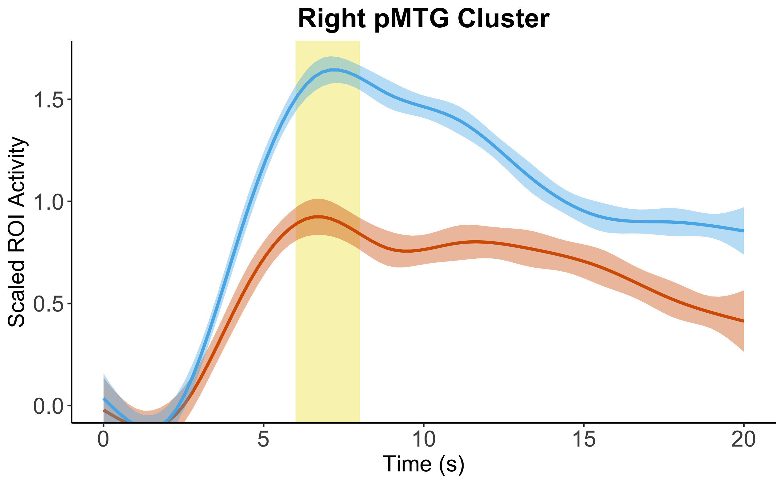
Vocal > Nonvocal (All Music)
A
0
11.05
Vocal > Nonvocal (Other-Selected Music Only)
B
0
8.65
Voxel Threshold: p < 0.05 (FDR-corrected)
Cluster Threshold: p < 0.05 (FDR-corrected)
C
Vocal vs. Nonvocal ROI Activation (averaged across all other-selected stimuli)
Vocal
Nonvocal

Slide 4
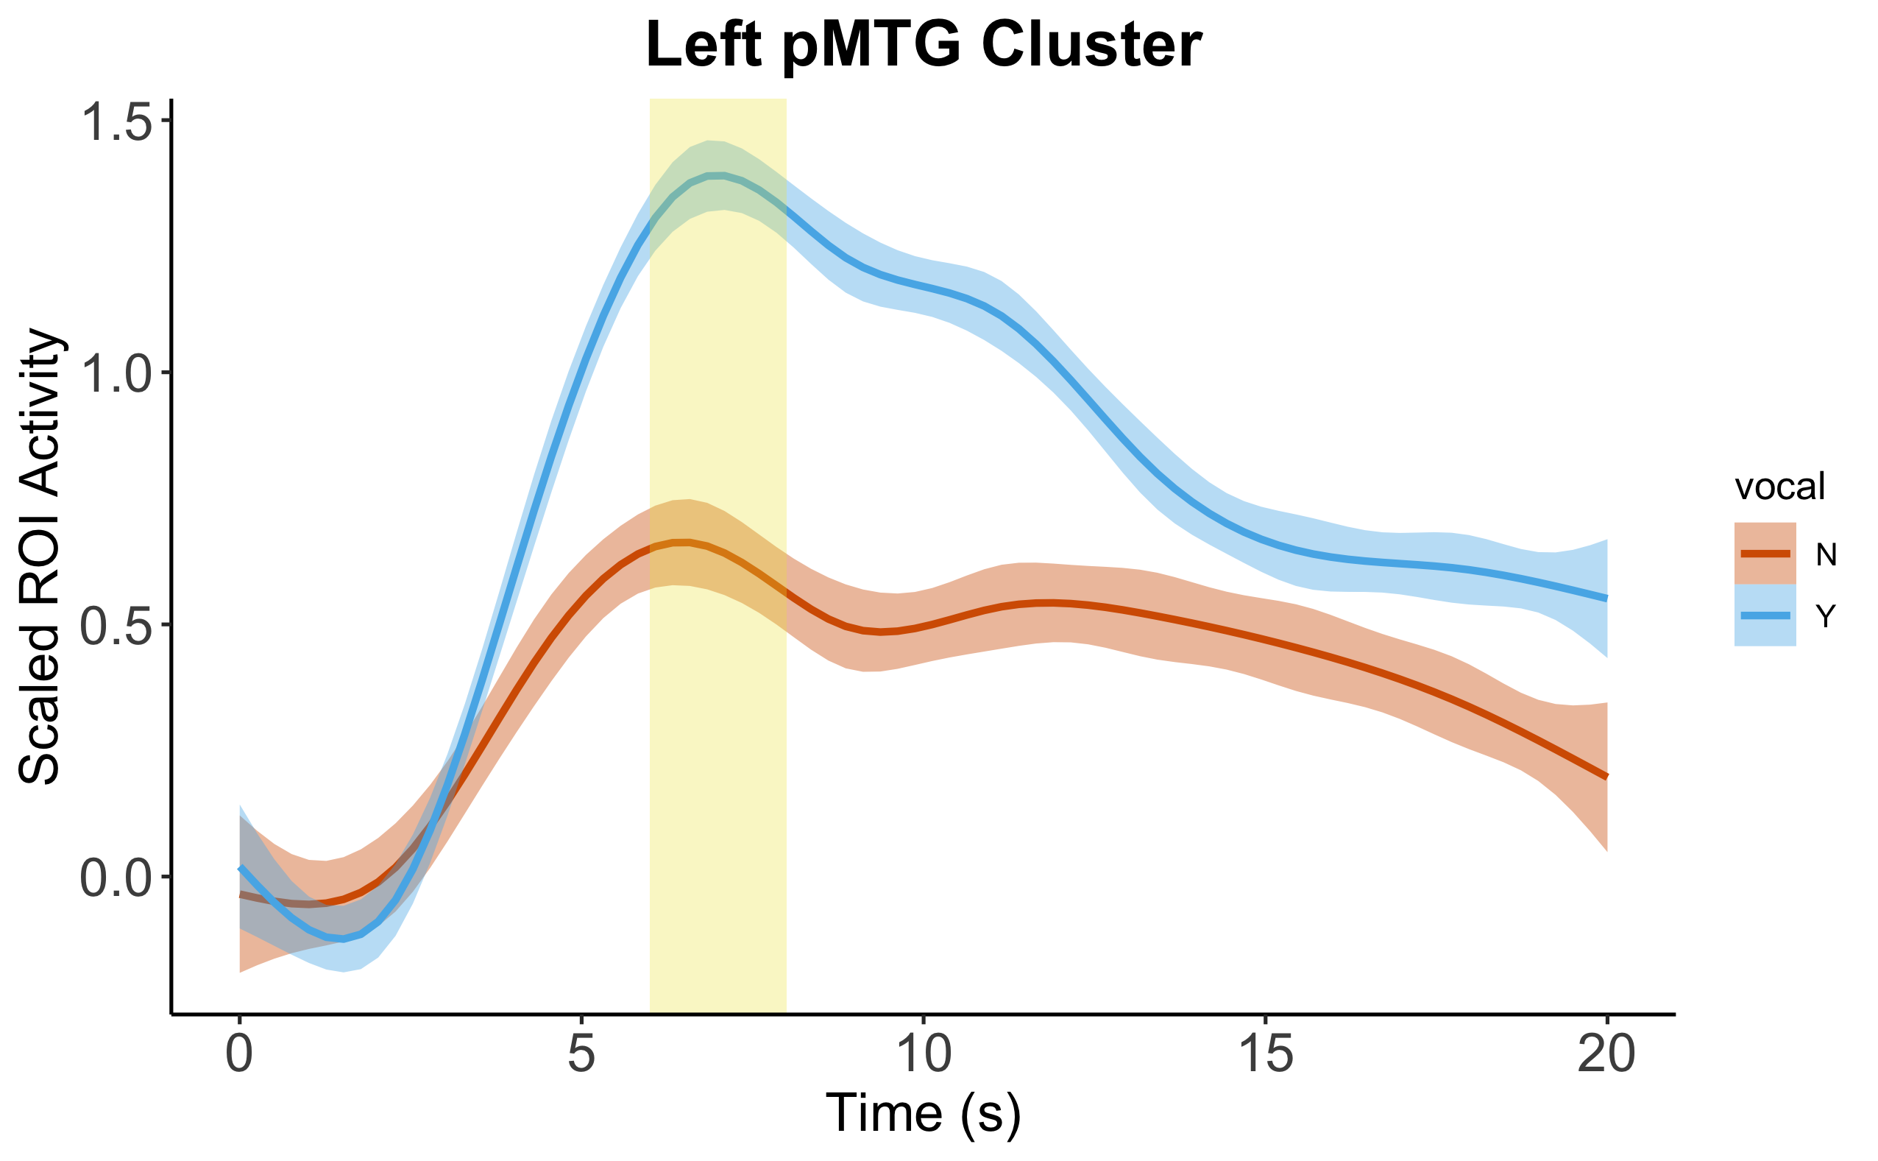
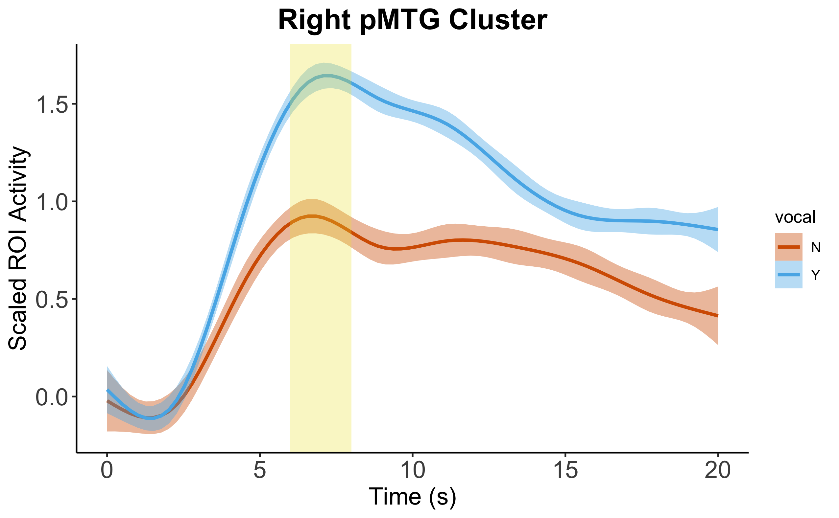
All Vocal > All Nonvocal
A
0
11.05
Other-Selected Vocal > Other-Selected Nonvocal
B
0
8.65
Vocal
Nonvocal
Voxel Threshold: p < 0.05 (FDR-corrected)
Cluster Threshold: p < 0.05 (FDR-corrected)
Vocal vs. Nonvocal ROI Activation (averaged across all other-selected stimuli)
C

Slide 5
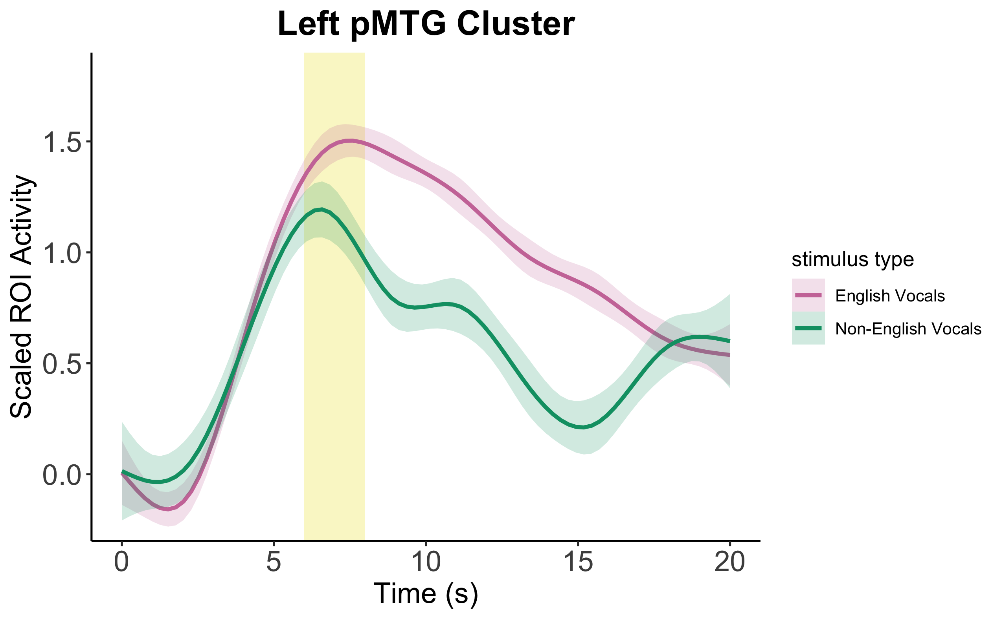
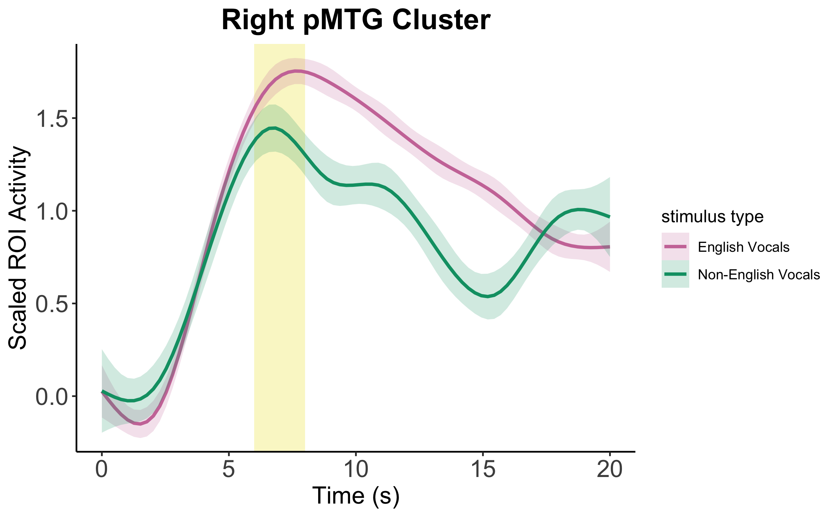
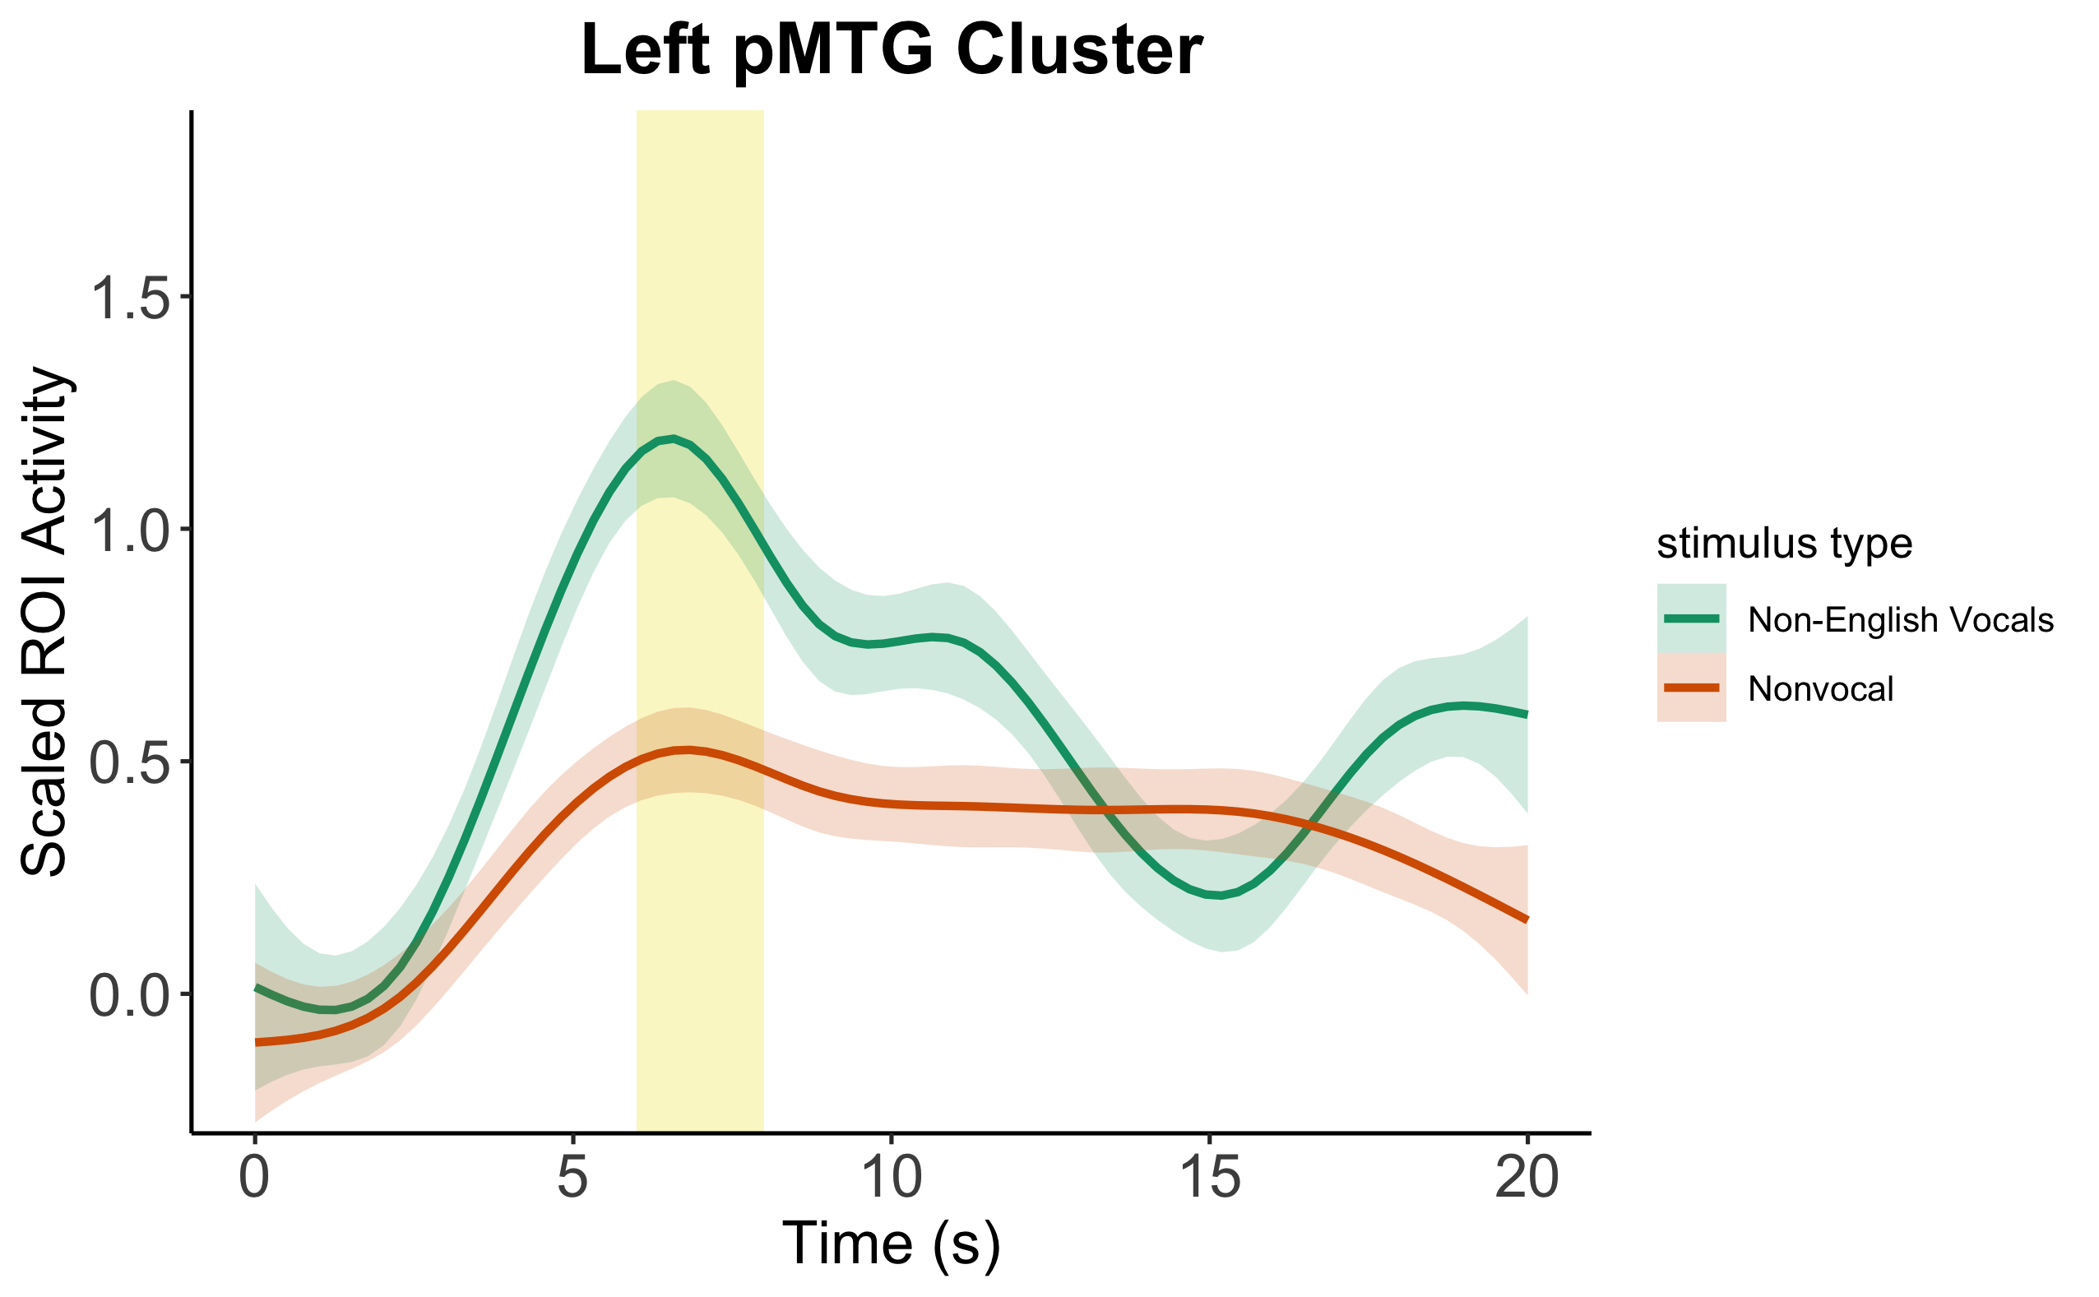
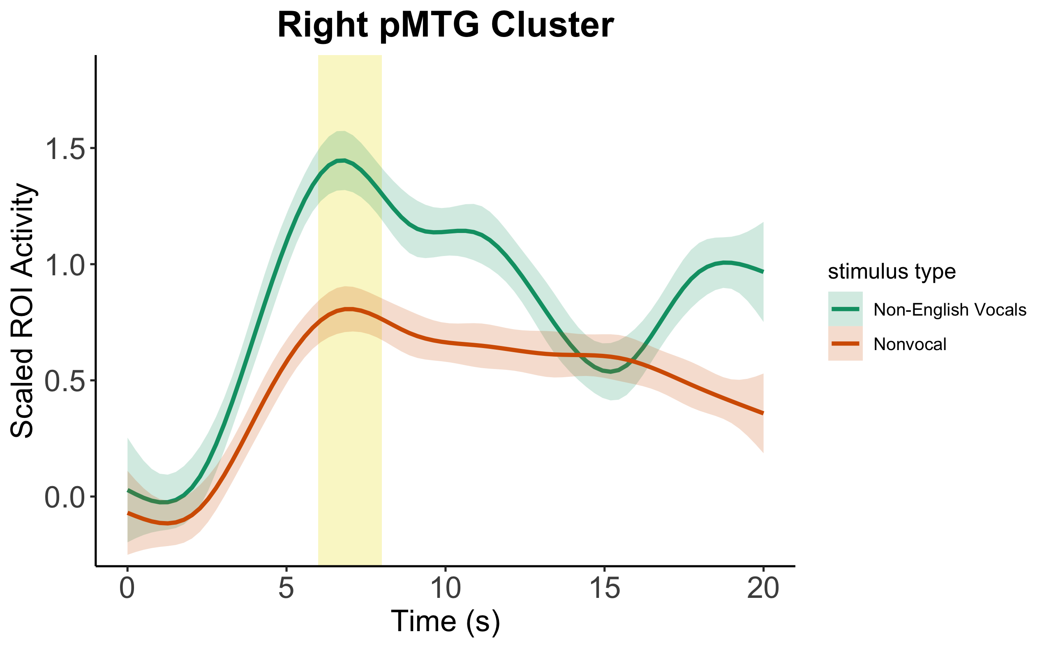
A
Vocals in English vs. Vocals in Another Language
English Vocals
Non-English Vocals
B
Vocals in Another Language vs. Nonvocal Music
Non-English Vocals
Nonvocal
Notes:
Future iteration could have pMTG brain clusters at the top of the left and right columns

Slide 6
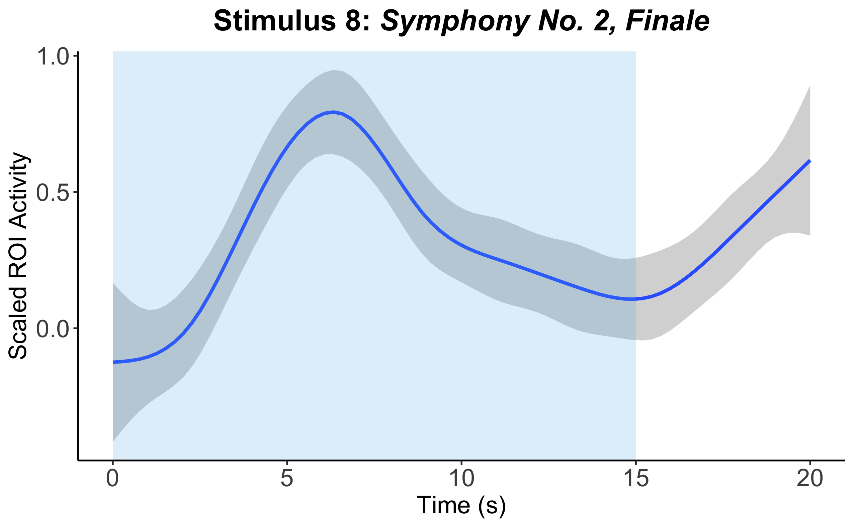
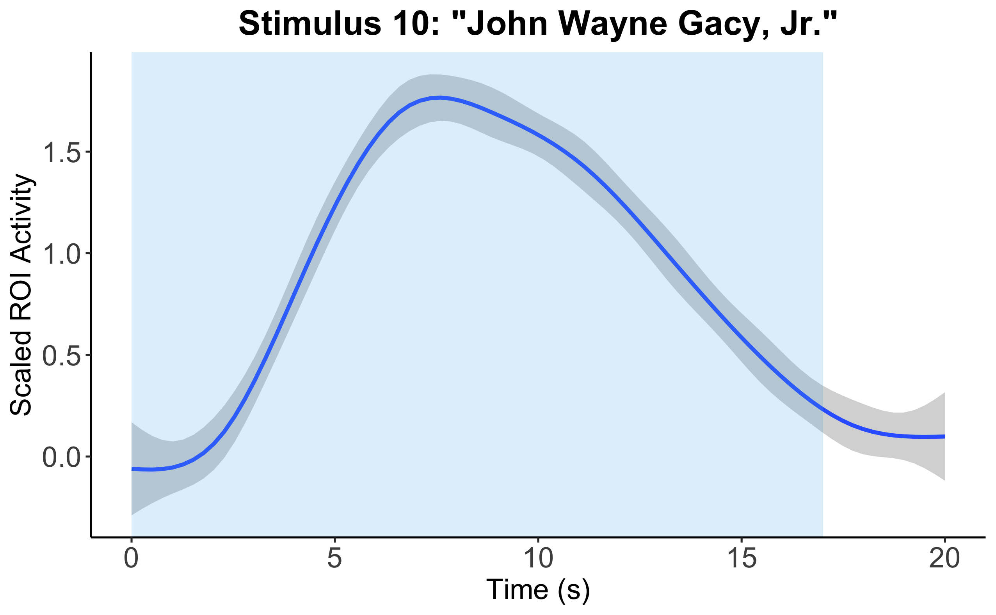
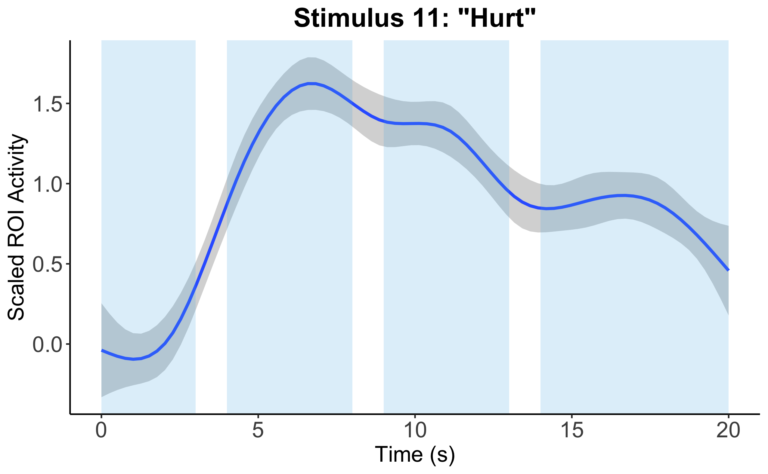
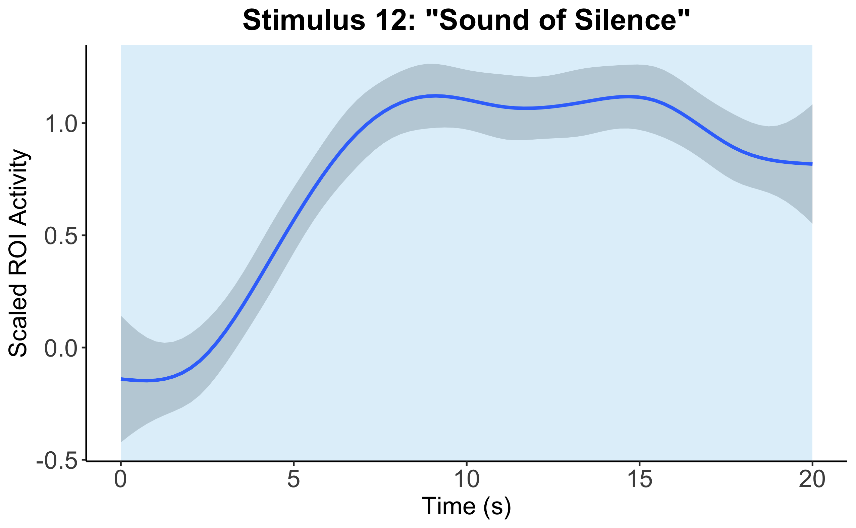
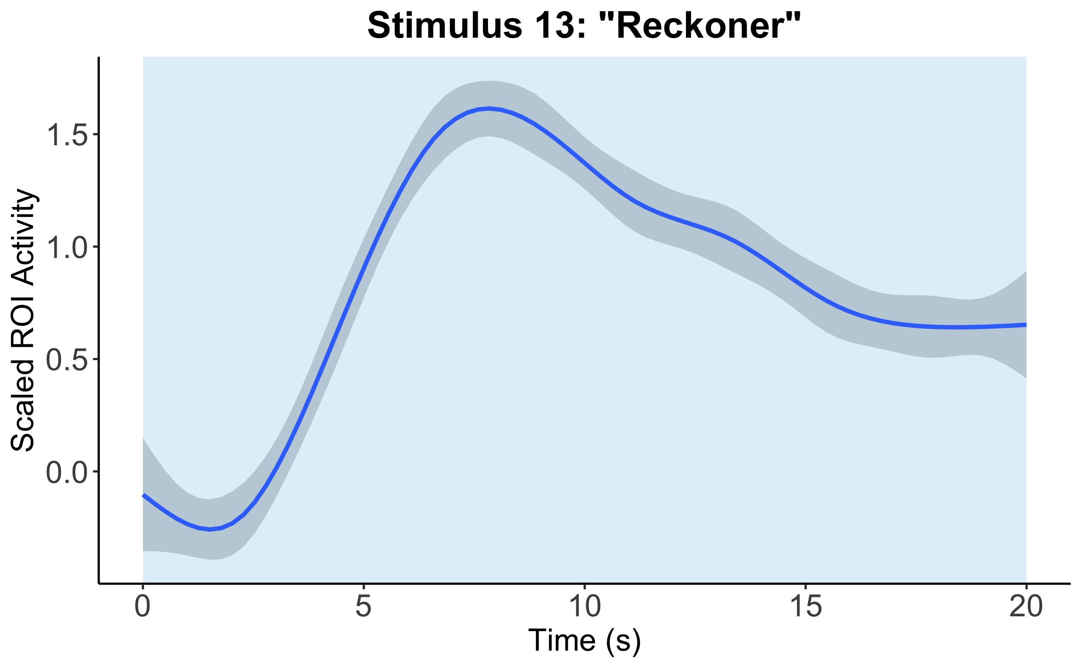
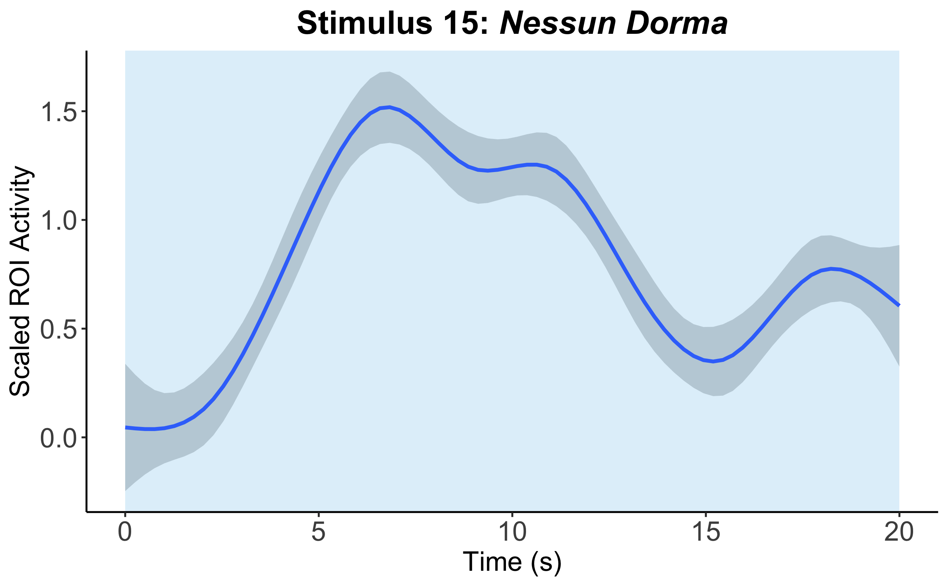
Time-Locked Vocal Onsets at pMTG Right Cluster (across all participants for each other-selected vocal stimulus)
A
indicates presence of vocals

Slide 7
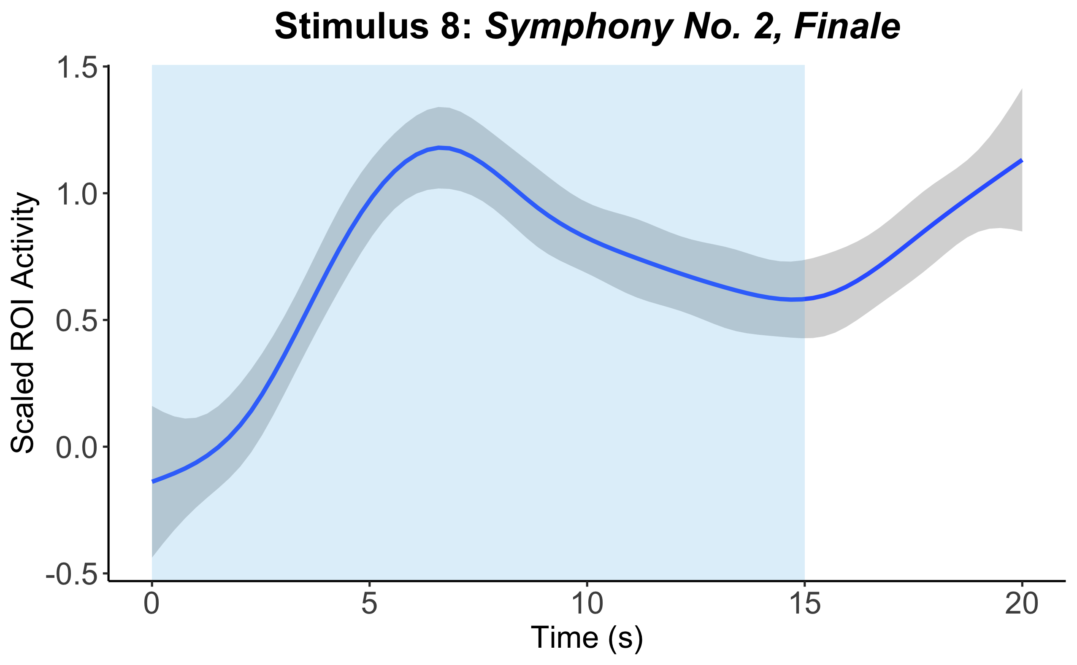
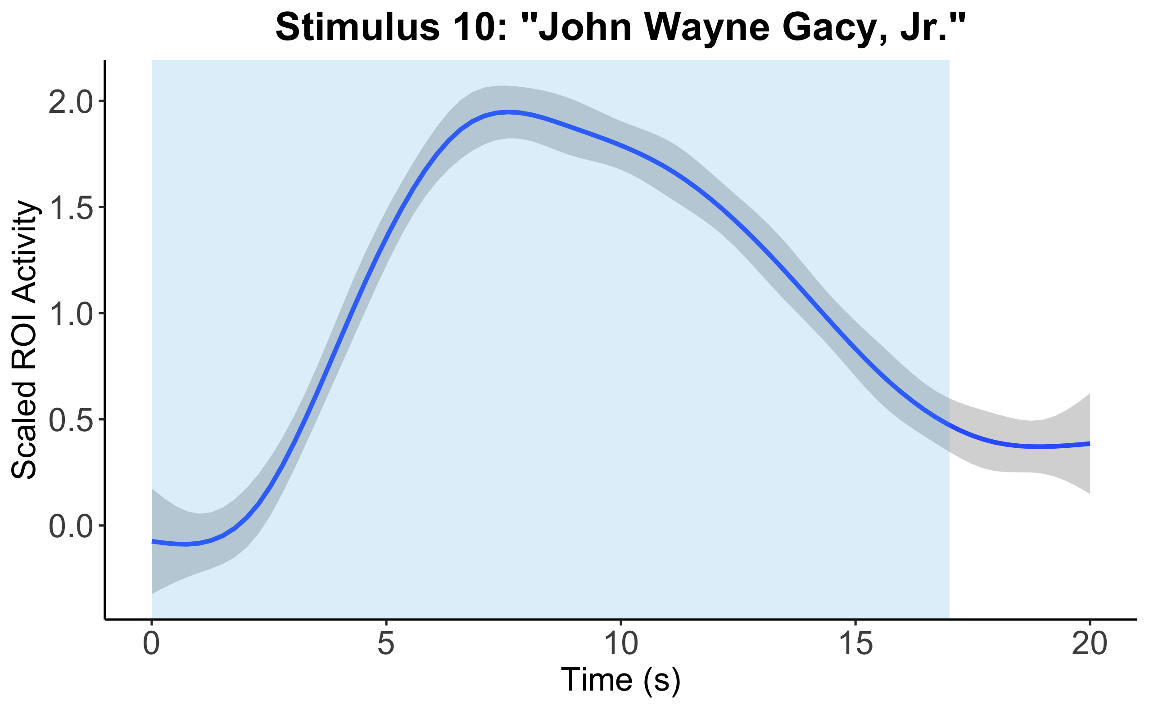
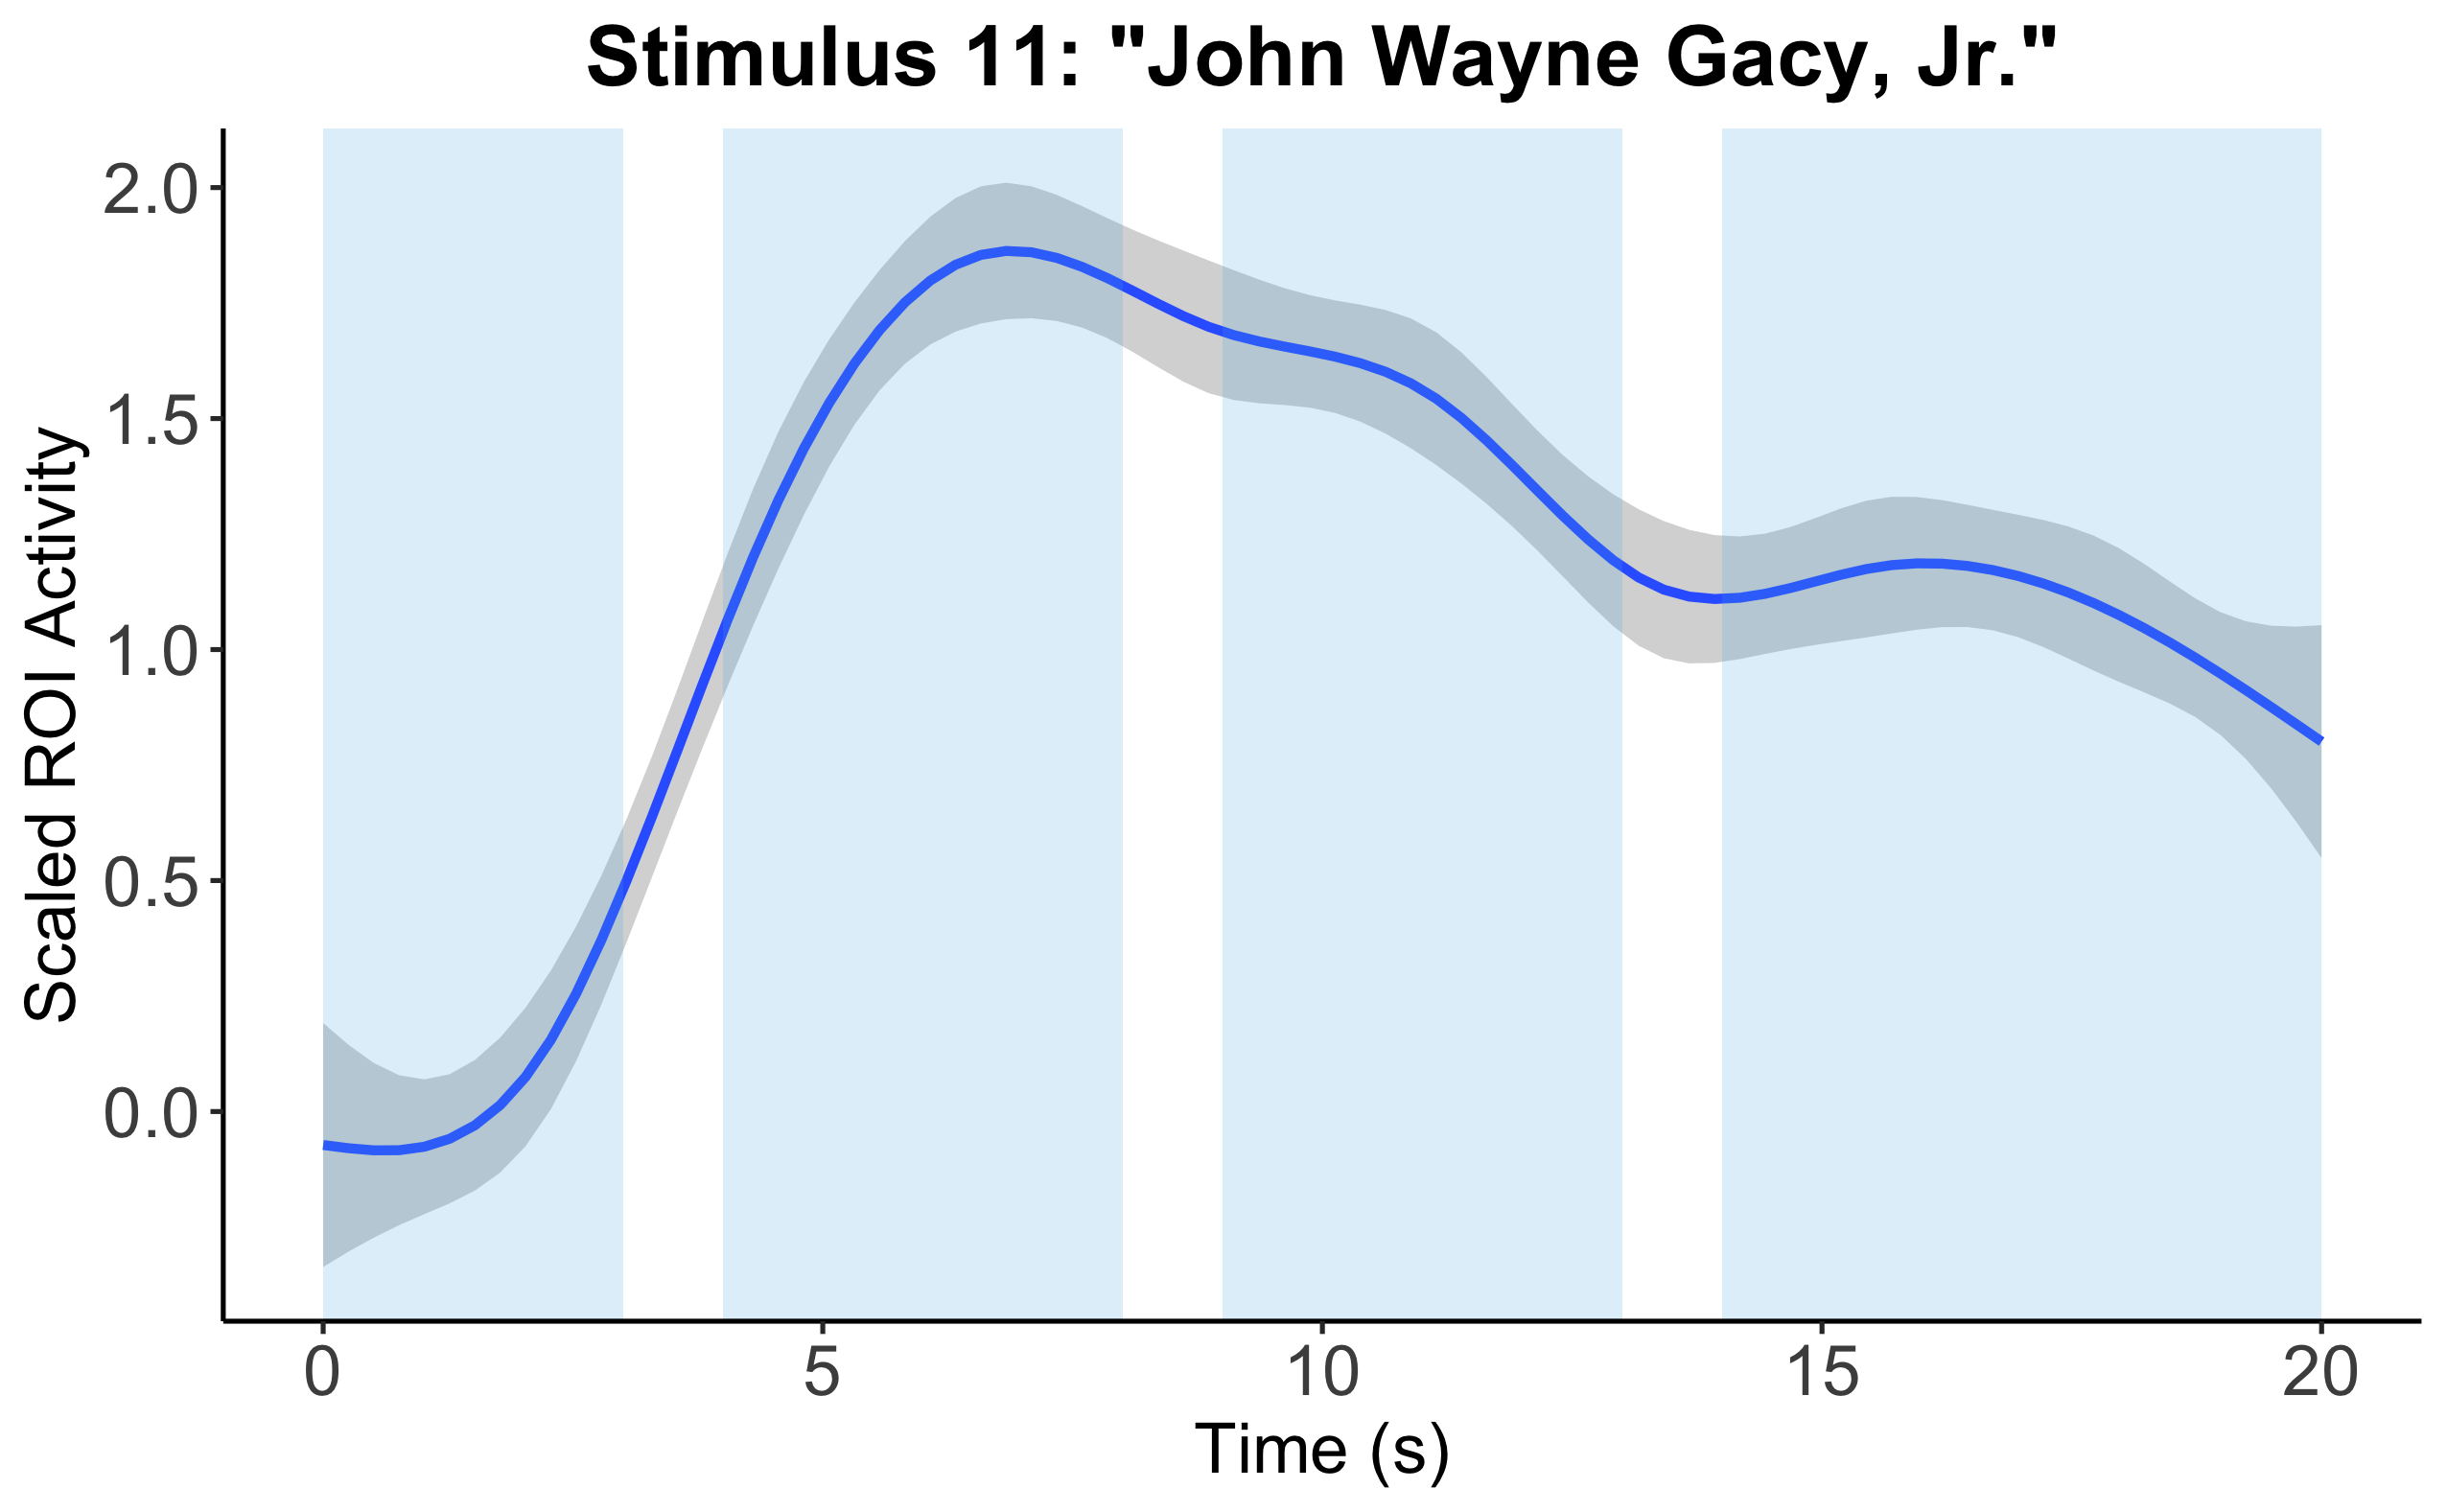
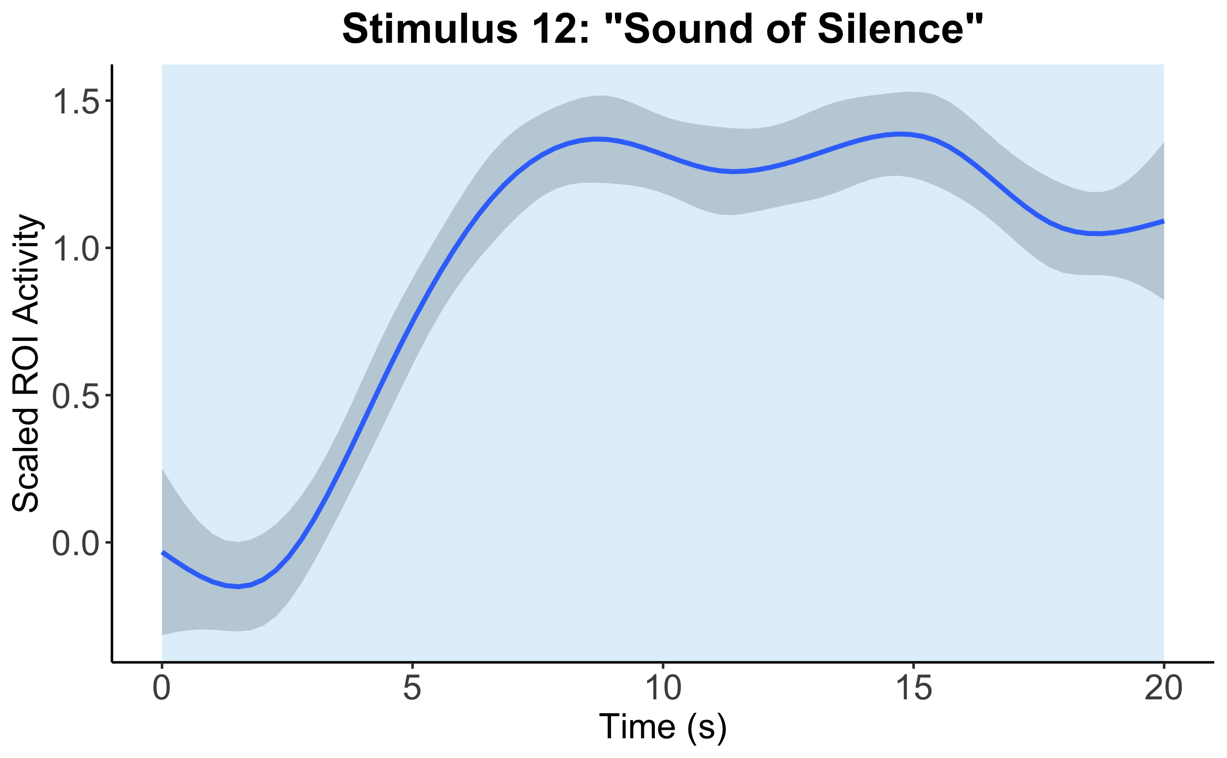
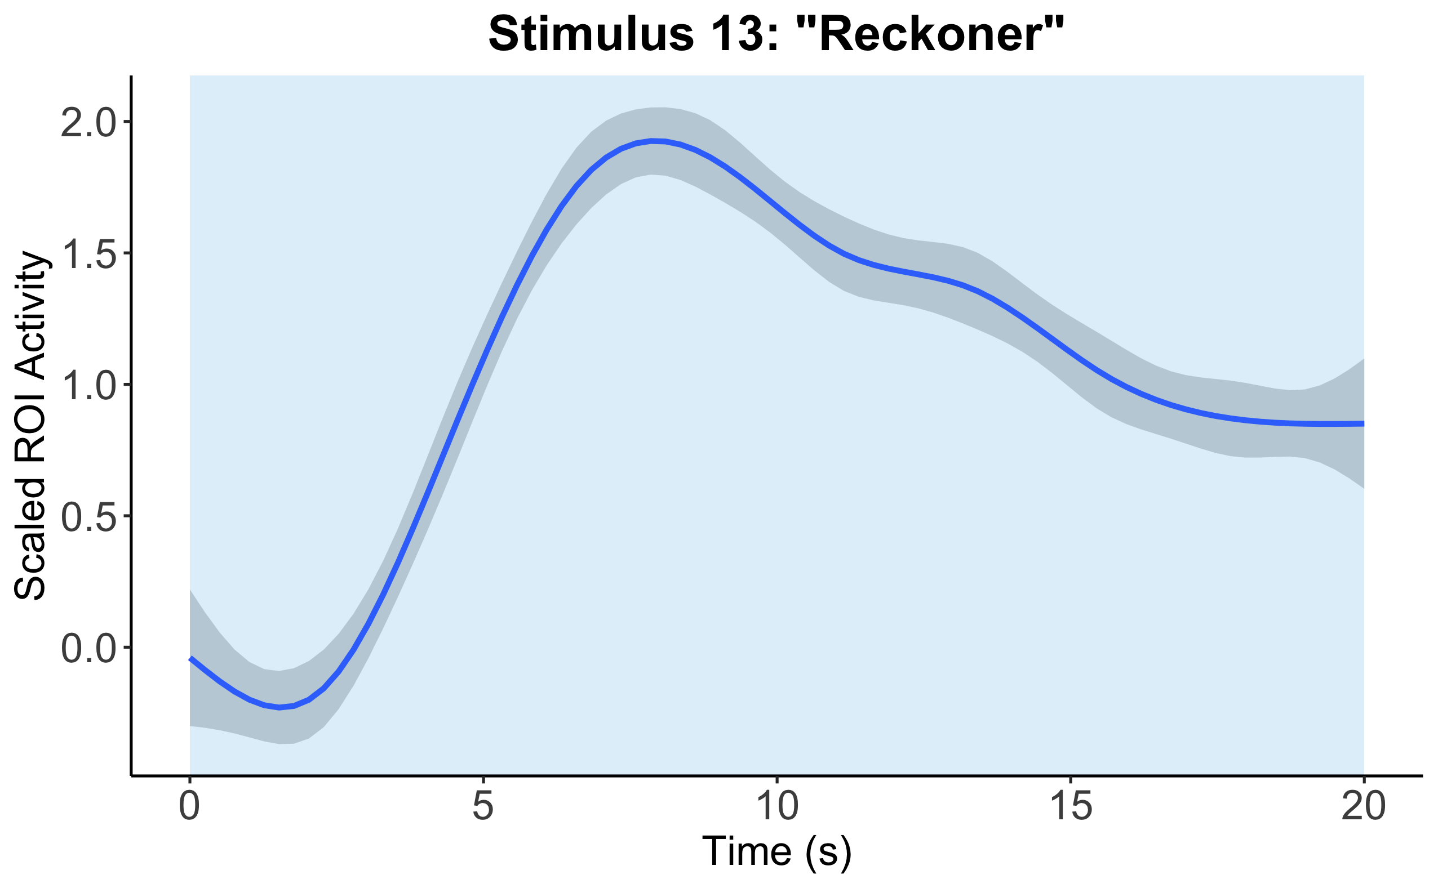
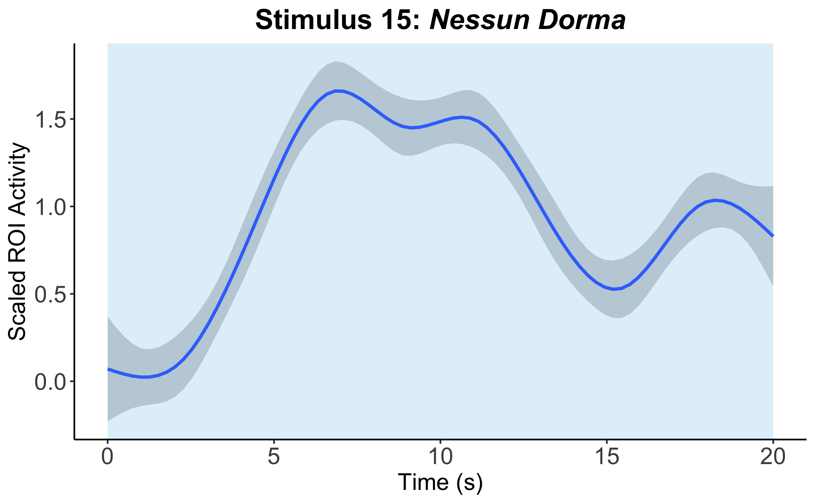
Time-Locked Vocal Onsets at pMTG Right Cluster (across all participants for each other-selected vocal stimulus)
B
indicates presence of vocals

Slide 8
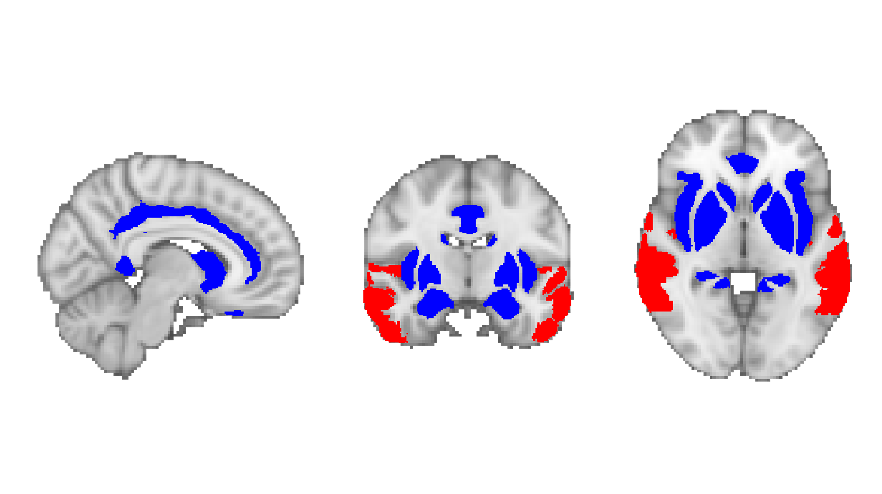
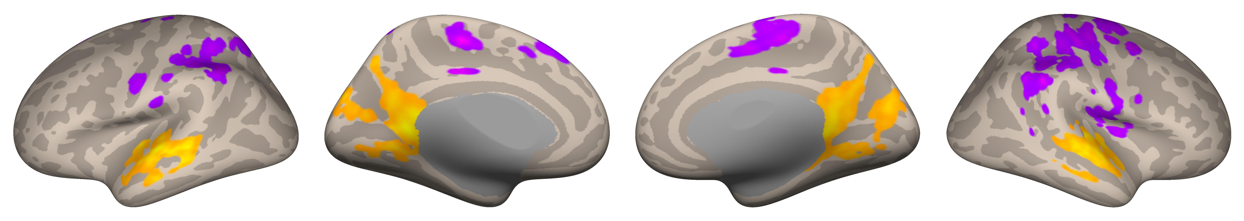
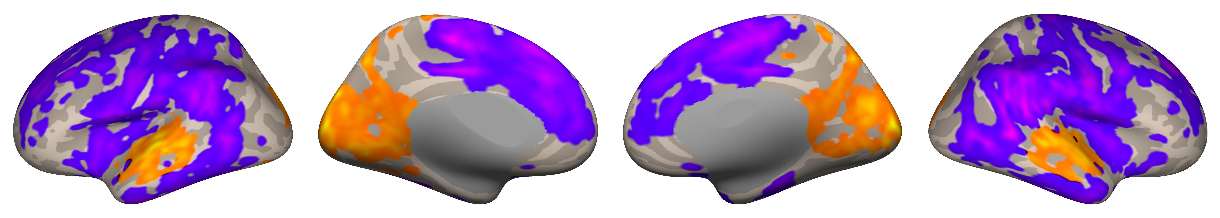
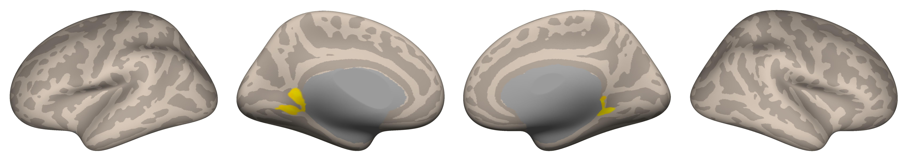
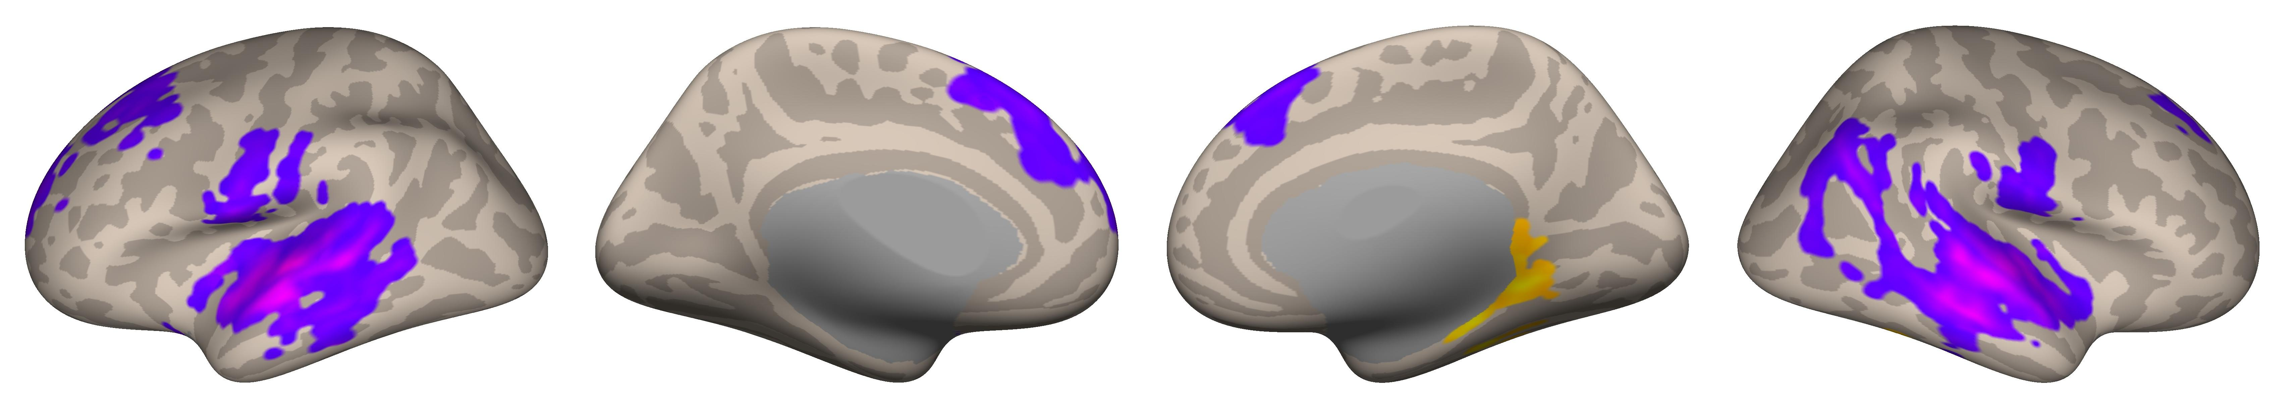
Reward System
Auditory System
A
Seed-Based Connectivity from Auditory Network
Vocal > Nonvocal (All Music)
-5.50
5.63
Vocal > Nonvocal (Other-Selected Music Only)
-6.47
4.93
Seed-Based Connectivity from Reward Network
B
Vocal > Nonvocal (All Music)
0
5.50
Vocal > Nonvocal (Other-Selected Music Only)
-5.88
2.96
Voxel Threshold: p < 0.05 (FDR-corrected)
Cluster Threshold: p < 0.05 (FDR-corrected)

Slide 9
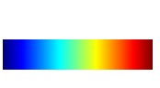
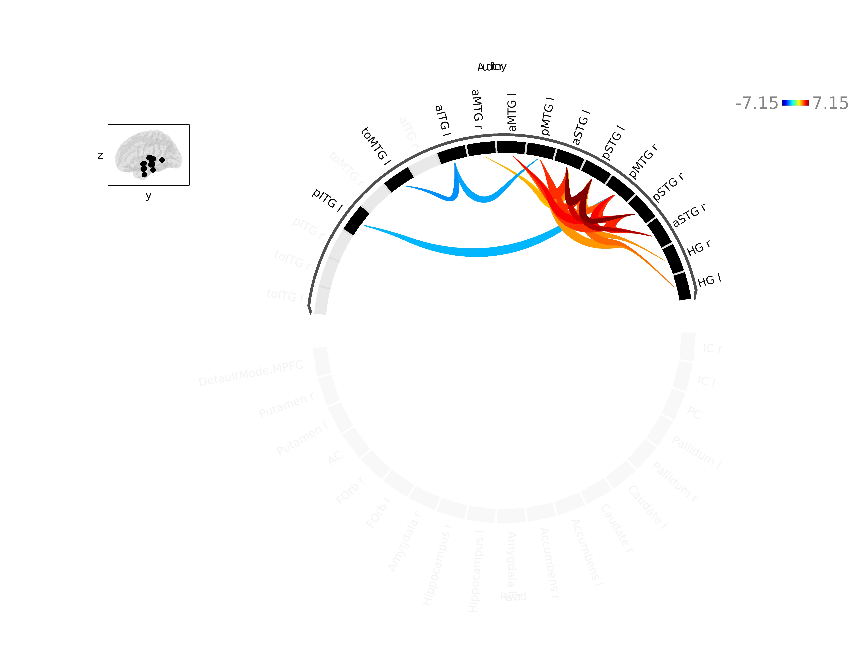
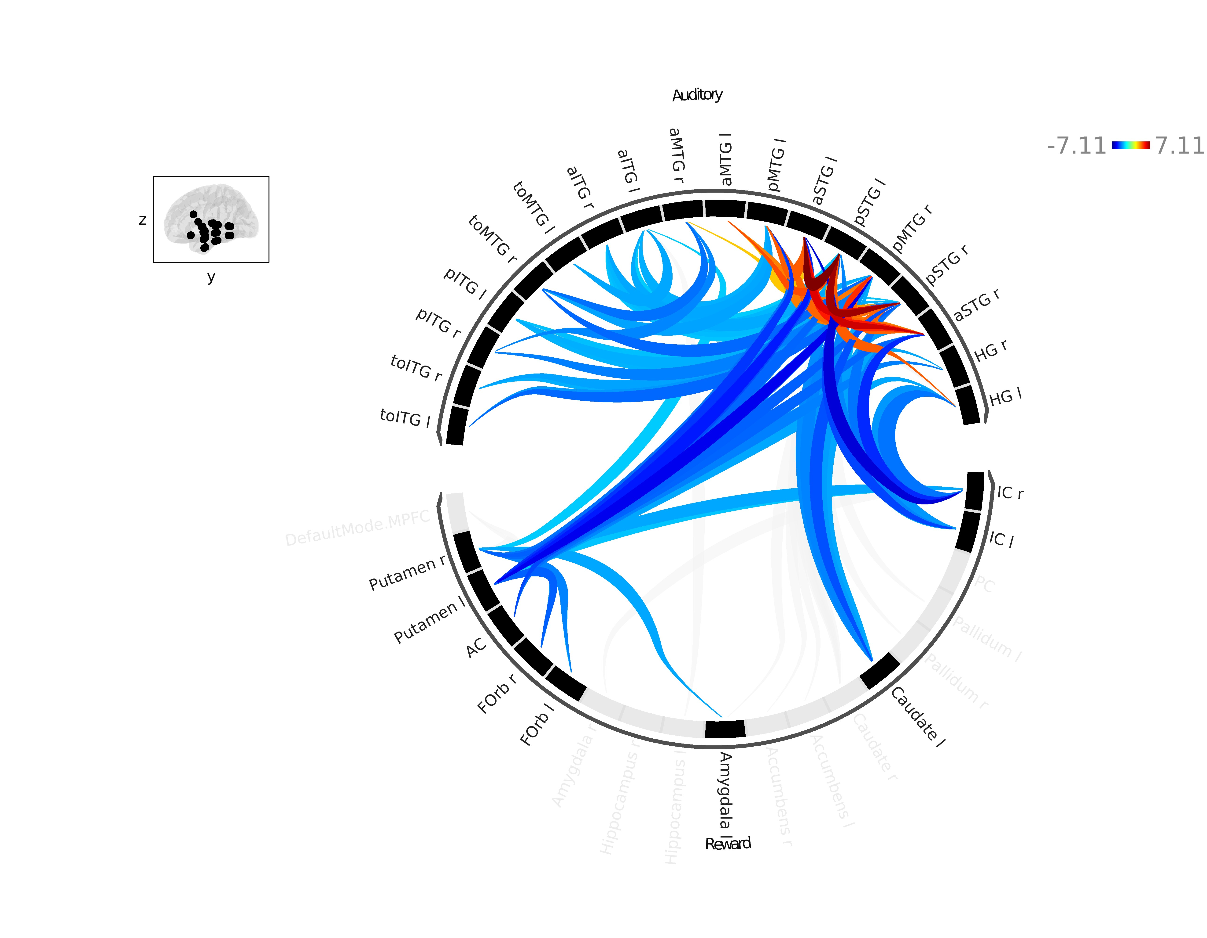
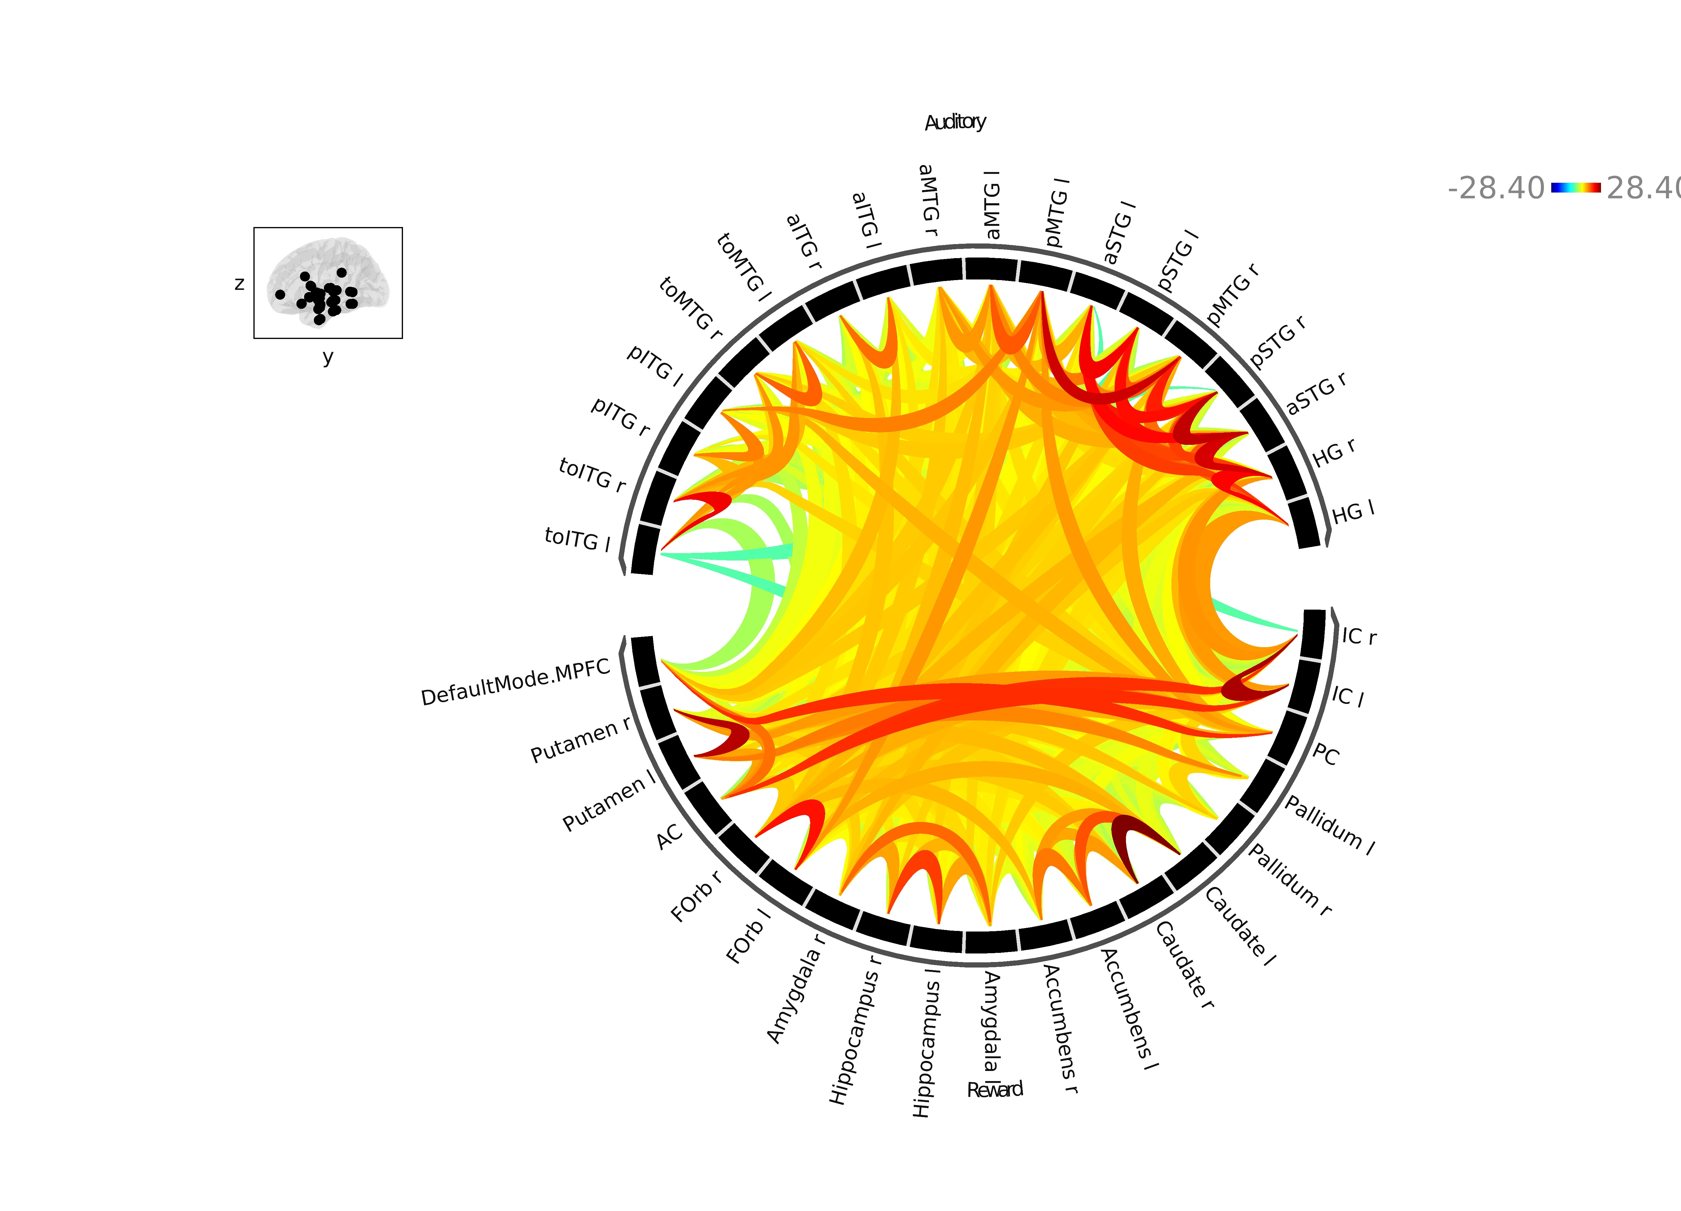
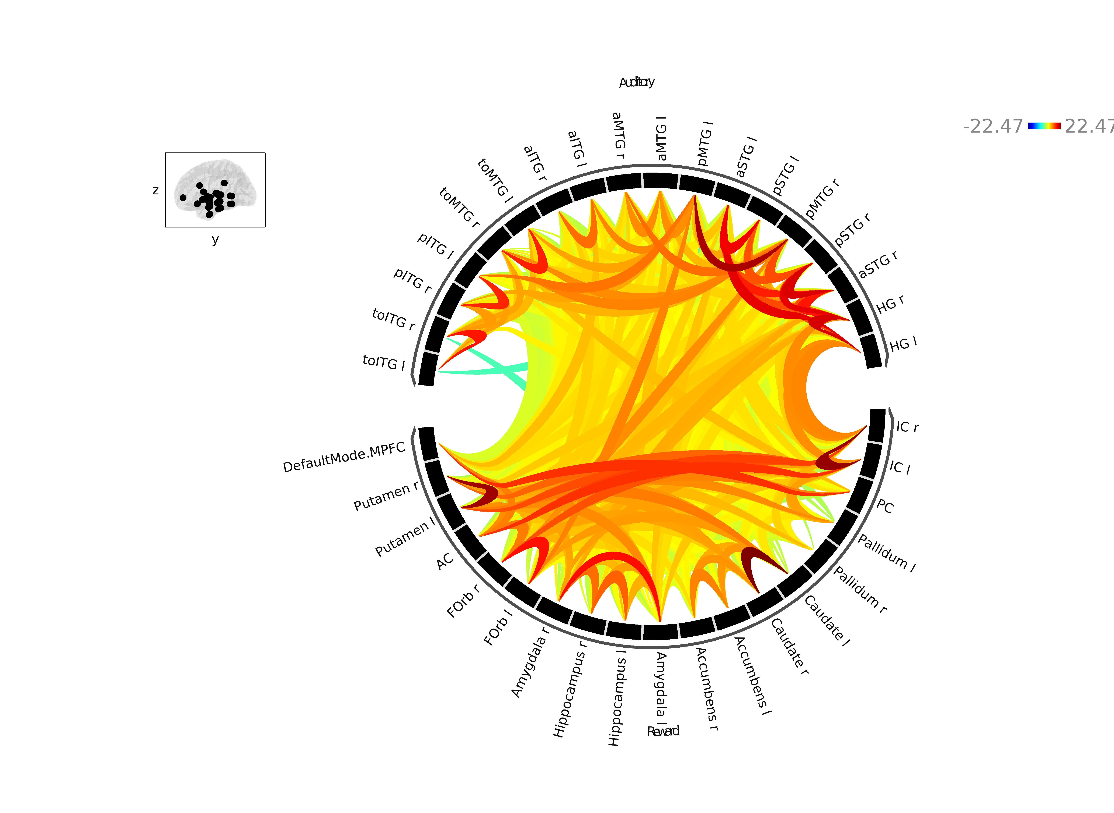
ROI-to-ROI Connectivity Within and Between
Auditory and Reward Networks
A Vocal > Nonvocal (All Music)
B Vocal > Nonvocal (OS Music)
-7.15 7.15
Auditory Network
-7.11 7.11
Auditory Network
Reward Network
Reward Network
C Vocal Main Effect
D Nonvocal Main Effect
-28.40 28.40
Auditory Network
-22.47 22.47
Auditory Network
Reward Network
Reward Network

Slide 10
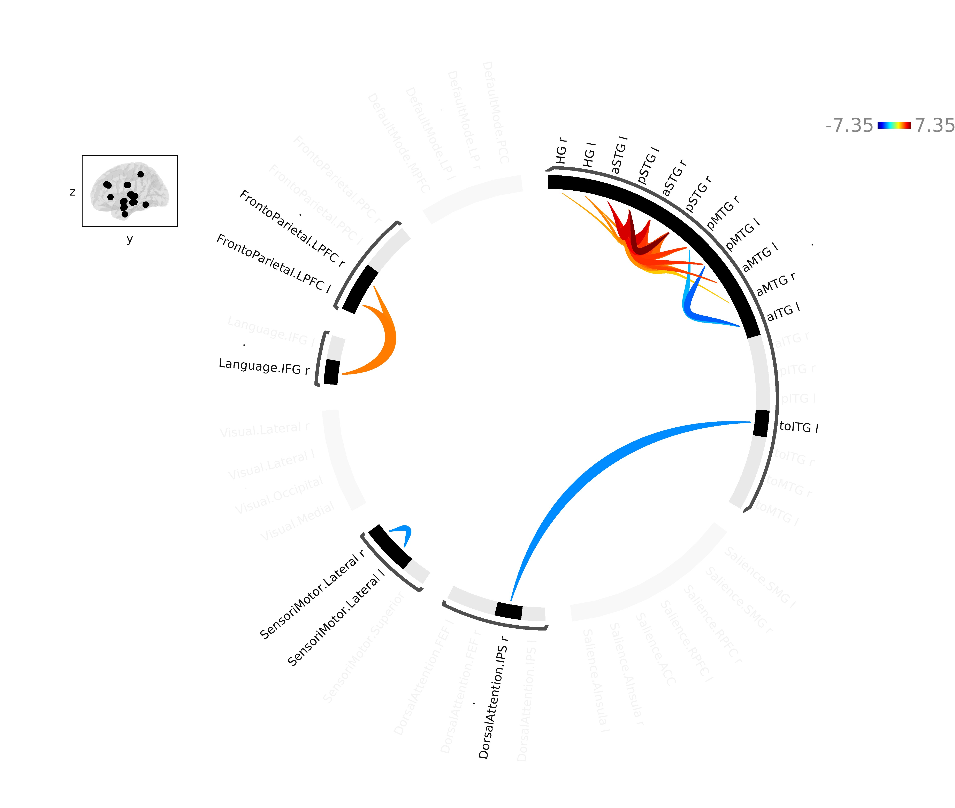
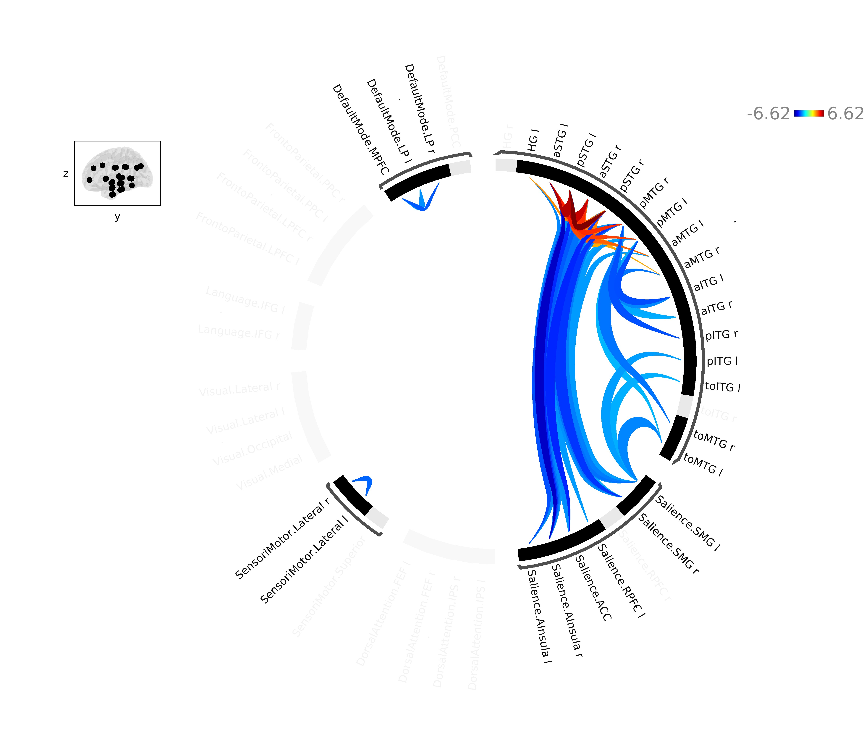
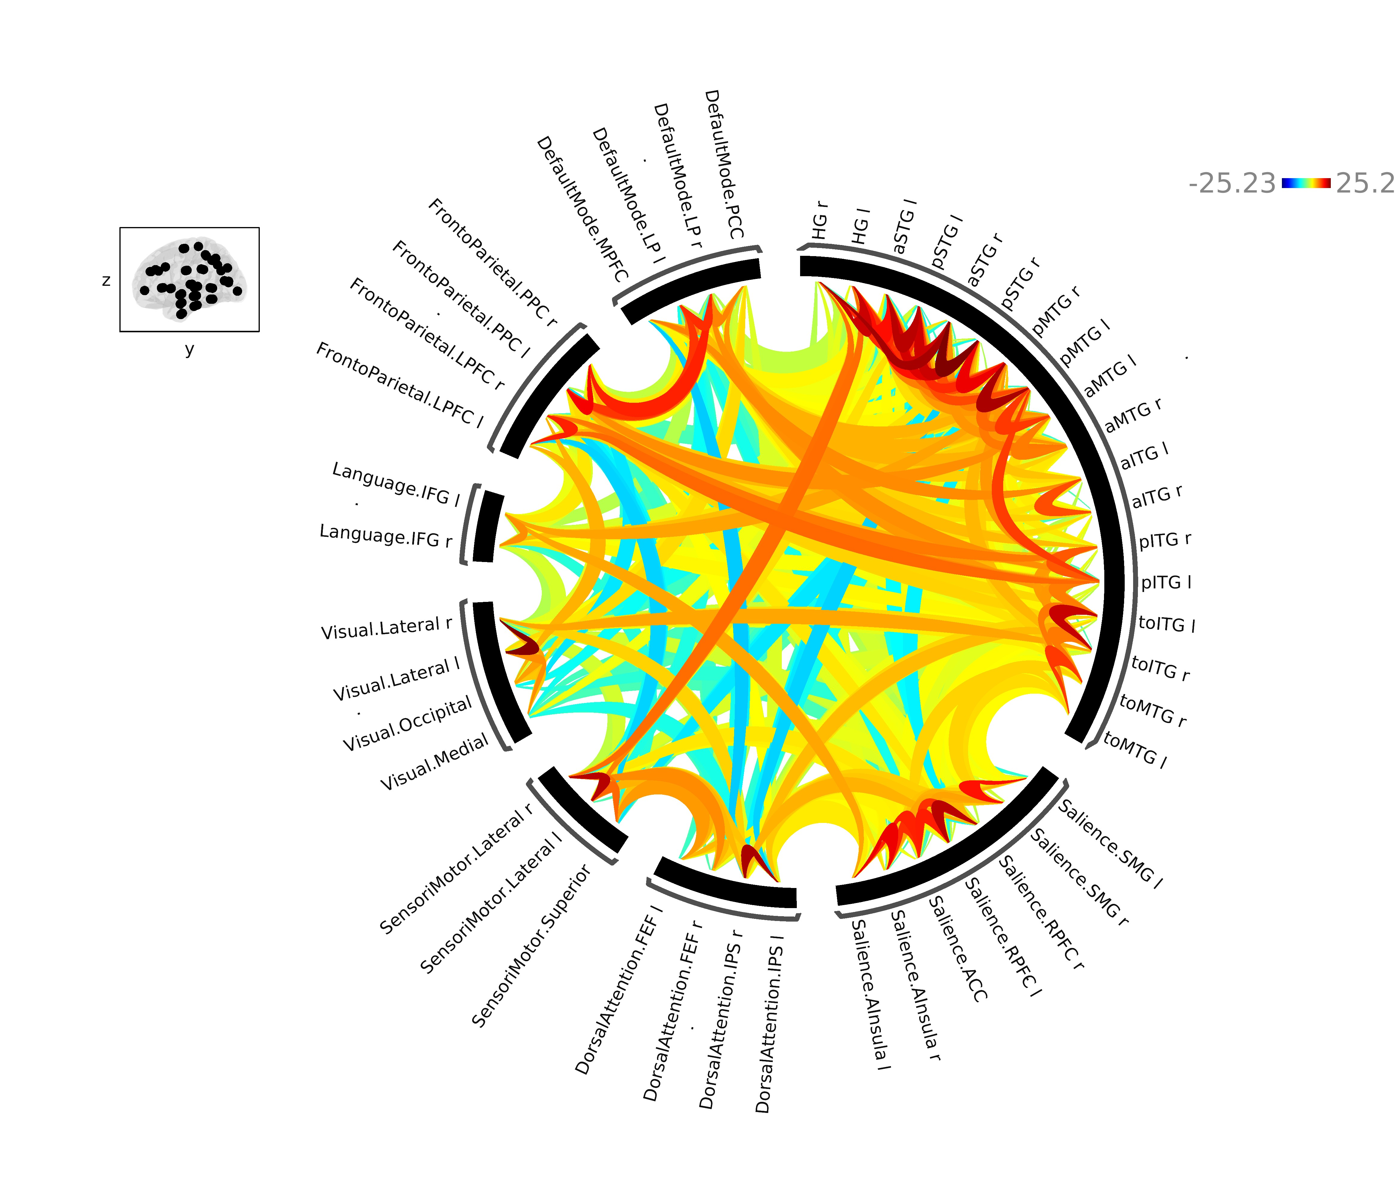
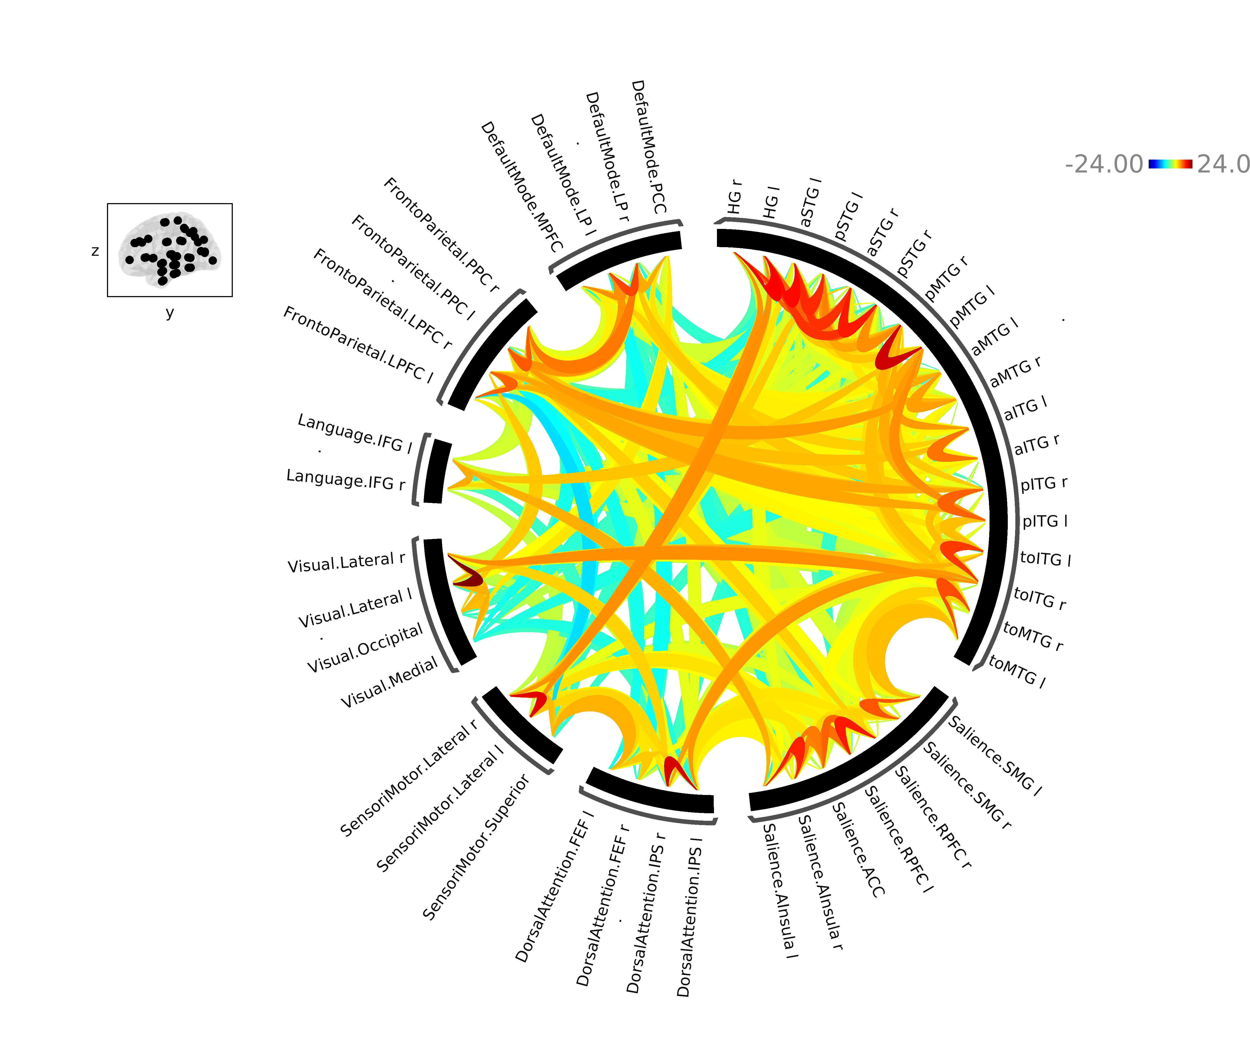
ROI-to-ROI Connectivity Within and Between
CONN Default Atlas Networks
A Vocal > Nonvocal (All Music)
B Vocal > Nonvocal (OS Music)
DEFAULT MODE
-7.35 7.35
DEFAULT MODE
-6.62 6.62
FRONTOPARIETAL
FRONTOPARIETAL
AUDITORY
AUDITORY
LANGUAGE
LANGUAGE
VISUAL
VISUAL
SENSORIMOTOR
SALIENCE
SENSORIMOTOR
SALIENCE
DORSAL ATTENTION
DORSAL ATTENTION
C Vocal Main Effect
D Nonvocal Main Effect
DEFAULT MODE
-25.23 25.23
DEFAULT MODE
-24.00 24.00
FRONTOPARIETAL
FRONTOPARIETAL
AUDITORY
AUDITORY
LANGUAGE
LANGUAGE
VISUAL
VISUAL
SENSORIMOTOR
SALIENCE
SENSORIMOTOR
SALIENCE
DORSAL ATTENTION
DORSAL ATTENTION

Slide 11
ROI-to-ROI Connectivity Within and Between
Auditory and Reward Networks
A Vocal > Nonvocal (All Music)
B Vocal > Nonvocal (OS Music)
-7.15 7.15
Auditory Network
-7.11 7.11
Auditory Network
VISUAL
Reward Network
Reward Network
ROI-to-ROI Connectivity Within and Between
CONN Default Atlas Networks
C Vocal > Nonvocal (All Music)
D Vocal > Nonvocal (OS Music)
DEFAULT MODE
-7.35 7.35
DEFAULT MODE
-6.62 6.62
FRONTOPARIETAL
FRONTOPARIETAL
AUDITORY
AUDITORY
LANGUAGE
LANGUAGE
VISUAL
VISUAL
SENSORIMOTOR
SALIENCE
SENSORIMOTOR
SALIENCE
DORSAL ATTENTION
DORSAL ATTENTION

Slide 12
ROI-to-ROI Connectivity for Vocal > Nonvocal (All Music)
A
Auditory Network
-7.15 7.15
B
DEFAULT MODE
-7.35 7.35
FRONTOPARIETAL
AUDITORY
LANGUAGE
VISUAL
SENSORIMOTOR
SALIENCE
Reward Network
DORSAL ATTENTION
ROI-to-ROI Connectivity for Vocal > Nonvocal (OS Music)
A
Auditory Network
-7.11 7.11
B
-6.62 6.62
DEFAULT MODE
FRONTOPARIETAL
AUDITORY
LANGUAGE
VISUAL
VISUAL
SENSORIMOTOR
SALIENCE
Reward Network
DORSAL ATTENTION

Slide 13
ROI-to-ROI Connectivity Main Effects Within and Between
Auditory and Reward Networks
A Vocal Main Effect
B Nonvocal Main Effect
-28.40 28.40
Auditory Network
-22.47 22.47
Auditory Network
Reward Network
Reward Network
ROI-to-ROI Connectivity Main Effects Within and Between
CONN Default Atlas Networks
C Vocal Main Effect
D Nonvocal Main Effect
DEFAULT MODE
-25.23 25.23
DEFAULT MODE
-24.00 24.00
FRONTOPARIETAL
FRONTOPARIETAL
AUDITORY
AUDITORY
LANGUAGE
LANGUAGE
VISUAL
VISUAL
SENSORIMOTOR
SALIENCE
SENSORIMOTOR
SALIENCE
DORSAL ATTENTION
DORSAL ATTENTION

Slide 14
ROI-to-ROI Connectivity in Auditory and Reward Networks
A Vocal > Nonvocal (All Music)
B Vocal > Nonvocal (OS Music)
-7.15 7.15
Auditory Network
-7.11 7.11
Auditory Network
Reward Network
Reward Network
C Vocal Main Effect
D Nonvocal Main Effect
-28.40 28.40
Auditory Network
-22.47 22.47
Auditory Network
Reward Network
Reward Network

Slide 15
Region | Side | β-Value | df | T-Value | p-value
Auditory Regions
aSTG | L | -0.113 | 206.999 | -1.370 | 0.172
aSTG | R | -0.115 | 197.018 | -1.394 | 0.165
pMTG | L | -0.049 | 216.194 | -0.727 | 0.468
pMTG | R | -0.038 | 169.831 | -0.570 | 0.569
Reward Regions
Amygdala | L | 0.064 | 181.984 | 0.663 | 0.508
Amygdala | R | -0.167 | 207.504 | -1.756 | 0.081
Caudate | L | -0.007 | 400.020 | -0.138 | 0.891
Caudate | R | 0.024 | 8.199 | 0.497 | 0.639
Insula | L | -0.013 | 205.247 | -0.176 | 0.861
Insula | R | 0.012 | 185.693 | 0.167 | 0.868
NAcc | L | 0.046 | 399.970 | 0.804 | 0.422
NAcc | R | -0.009 | 7.449 | -0.175 | 0.866
Other Regions
Hippocampus | L | 0.051 | 138.004 | 0.721 | 0.472
Hippocampus | R | -0.025 | 23.798 | -0.428 | 0.673

